Slide 1
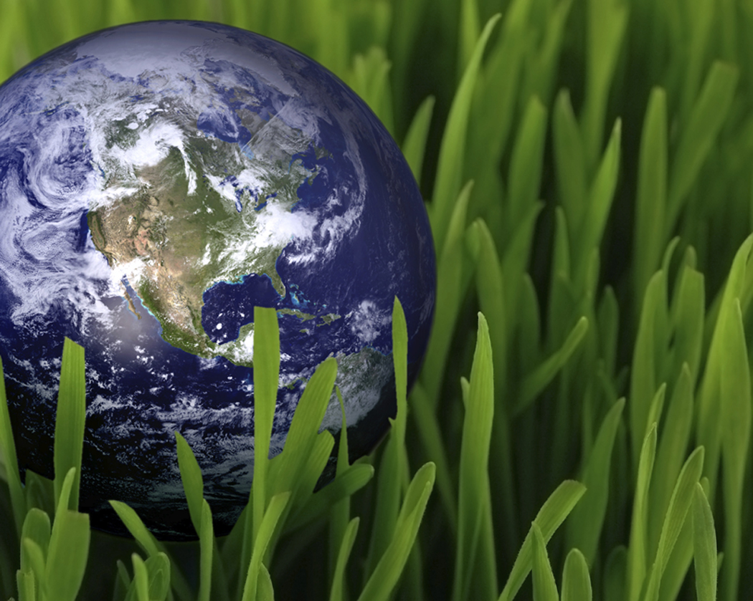
Factors that Shape an Ecosystem

Slide 2
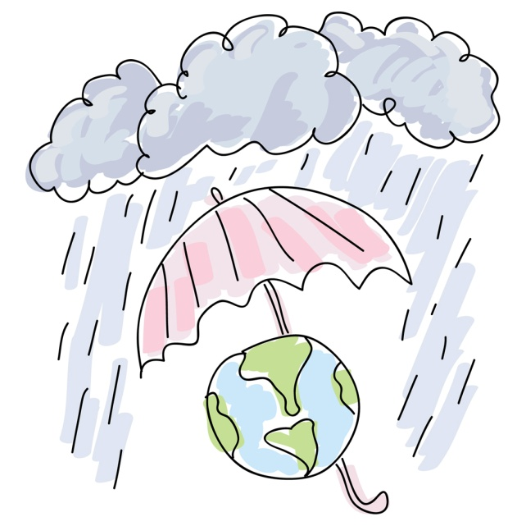
I. Climate
The year-to-year average of temperature and rainfall of an area

Slide 3
What are abiotic and biotic factors?

Slide 4
II. Abiotic and Biotic Factors
Abiotic: nonliving factors that influence an ecosystem
  Bodies of water (ocean, lake, pond, stream)
  Rocks, mountains, volcanoes
  Frequent fires
  Climate
  Soil type
Biotic: living factors that influence an ecosystem
  Plants
  Animals
  Fungi
  Protists
  Bacteria
  Archaea

Slide 5
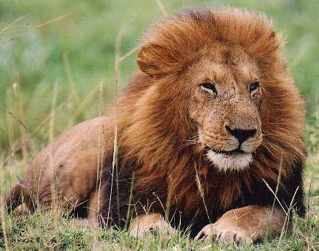
III. Habitat and Niche
Habitat: all the biotic and abiotic factors in the ecosystem where an organism lives
  Example: A lions habitat might include shade trees, tall grasses and watering holes
Niche: the way an organism interacts with its environment

Slide 6
Habitat and Niche
Think of a habitat as where as a species lives and a niche as how it lives within the habitat.
A niche includes:
  Food: the type it eats, how it competes with others, where it fits in the food web
  Abiotic Conditions: range of conditions such as temperature and amount of water available
  Behavior: time of day the species is active and where and when it reproduces

Slide 7
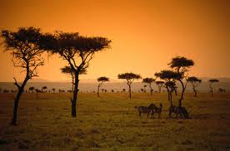
IV. Community Interactions
How organisms interact with each other within their environment
  Competition
  Predation
  Symbiosis
    Parasitism
    Mutualism
    Commensalism

Slide 8
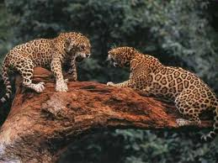
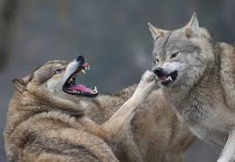
Community Interactions
Competition: when organisms desire the same ecological resource at the same time (food, living space, mate)

Slide 9
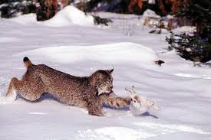
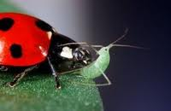
Community Interactions
2. Predation: one organism captures and feeds on another

Slide 10
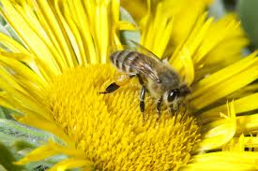
Community Interactions:
3. Symbiosis: any relationship in which organisms live closely together
Three types:
Parasitism
Mutualism
Commensalism

Slide 11
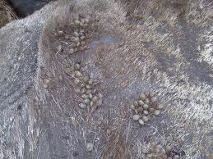
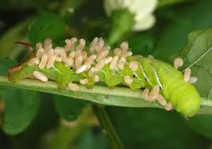
Community Interactions: Symbiosis
A. Parasitism: one organism lives on or in another and harms it

Slide 12
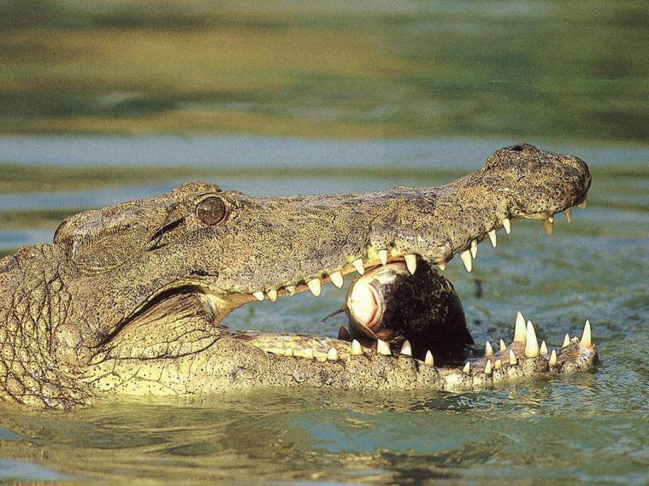
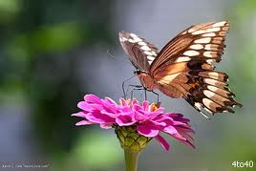
Community Interactions: Symbiosis
B. Mutualism: both species benefit from the relationship

Slide 13
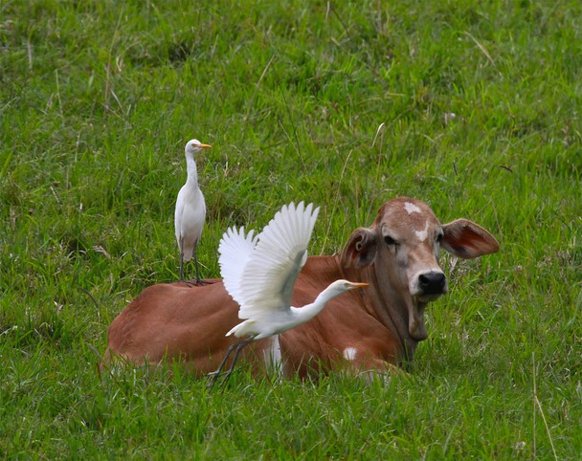
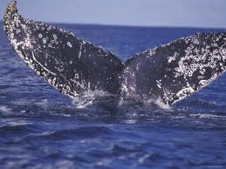
Community Interactions:
Symbiosis
C. Commensalism: one organism benefits and the other is neither helped or hurt

Slide 14
V. Ecological Succession
Ecosystems are constantly changing
  Natural and human disturbances
  Older inhabitants die out, new organisms move in
Ecological Succession: series of predictable changes that occurs in a community over time
  Primary succession
  Secondary succession

Slide 15
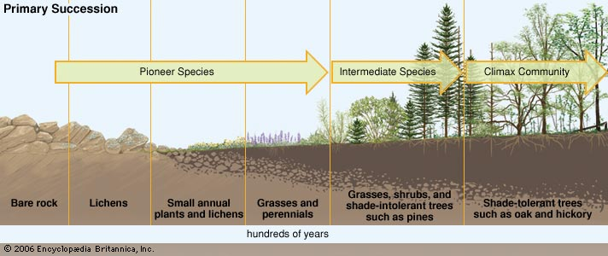
Primary Succession
Succession that occurs where no soil exists
  Ex. After volcanic eruption, retreating glacier
Pioneer species: first to appear in area
Order of species return:
  Lichens
  Mosses
  Grasses
  Shrubs
  Trees (pines first, then hardwoods such as oaks)

Slide 16
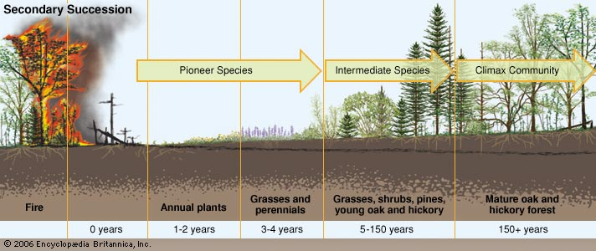
Secondary Succession
Disturbance of some kind changes an existing community without moving the soil
  Ex. Abandoned farmland, after wildfires

