Slide 1
February 12, 2019
LT: I can identify the types of muscles.
Warm-Up
Joints can be classified in what two categories? Describe both.

Slide 2
The Muscular System

Slide 3
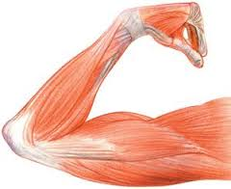
Muscle
Is an organ that can relax, contract, and provide the force to move your body parts.
Muscles help make all daily
movements possible.

Slide 4
Muscle Control
Involuntary
Voluntary

Slide 5
Involuntary Muscles
Muscles that are NOT controlled consciously.
These muscles work all day long, for your entire life.
EX. Food moving through digestive system, or blood being pumped through body (Circulatory and Digestive muscles)

Slide 6
Voluntary Muscles
Muscles that you are able to control. YOU CHOOSE TO MOVE THEM!
Hand, arm, and leg muscles

Slide 7
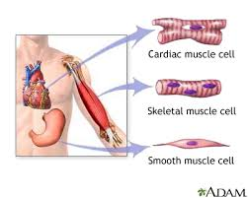
3 Types of Muscles
Skeletal muscle
Cardiac muscle
Smooth muscle

Slide 8
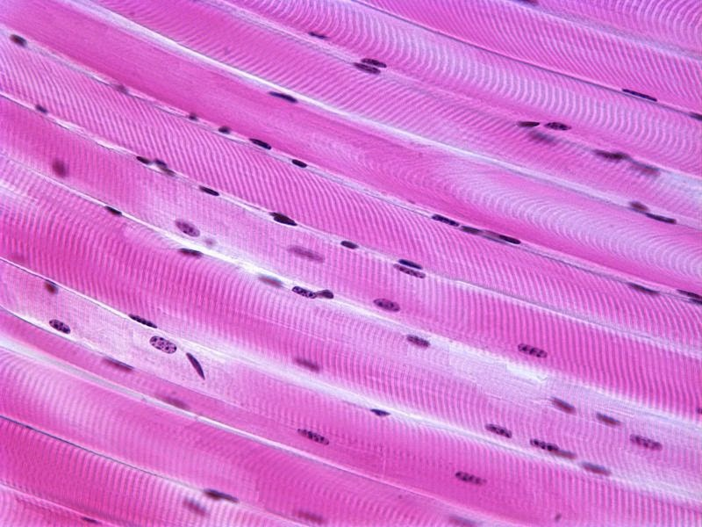
Skeletal Muscles
The muscles that move bones.
Attached to the bone
Have striated tissue
Voluntary muscle

Slide 9
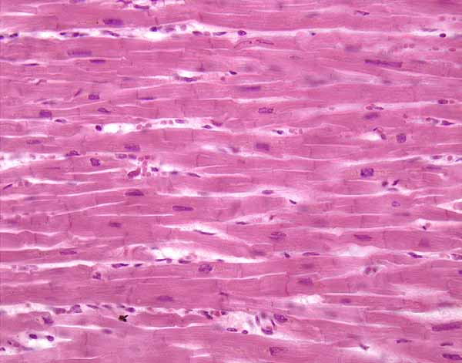
Cardiac Muscle
ONLY found in the heart
Involuntary muscle
Striated tissue

Slide 10
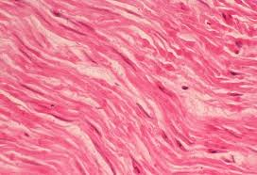
Smooth Muscle
Found in internal organs
No striations
Involuntary
Intestines, bladder, blood vessels

Slide 11
Changes in muscles
Over a period of time muscles can become larger or smaller
Depends on how often the muscle moves.

Slide 12
How Muscles move?
Muscles need energy to contract and relax.
Blood carries energy rich molecules to muscle cells where the chemical energy stored in these molecules is released.
When muscles contract the released energy turns into mechanical energy and thermal energy.

Slide 13
What happens when energy molecules are used up
Muscles become tired and needs to rest.
While resting the body supplies more energy rich molecules to muscle cells.
The heat that is produced helps maintain the body temperature.

Slide 14
February 15, 2018
LT: I can describe the different types of muscles.
Warm-Up
What are the 3 types of muscles?
The body is very similar to simple machines and levers. Do you agree or disagree with this statement? Why or why not?

