Slide 1
LT: *I can identify the layers of the skin.
Warm-Up
1. What type of bone cells make bones?
2. What type of bone cell break down bones?

Slide 2
Skin
(the largest organ)

Slide 3
Skin structure
Epidermis
Dermis
Hypodermis (Fatty Layer)

Slide 4
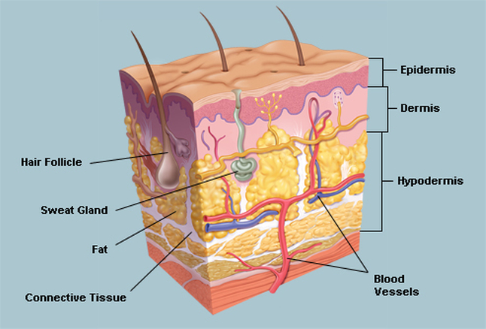

Slide 5
Epidermis
The outer, thinnest layer of the skin
The outer most layers of the epidermis consist of dead cells that are water repellent
You lose thousands of epidermal cells every time you take a shower, shake your hand, blow your nose or scratch your elbow.
New cells are produced at the base of the epidermis

Slide 6
Dermis
Layer of cells directly below the epidermis
Thicker than the epidermis
Contains many blood vessels, nerves, muscles, oil and sweat glands

Slide 7
Hypodermis (Fatty layer)
The fatty region that insulates the body
Where most of the fat is deposited when a person gains weight
Connective tissue

Slide 8
Melanin
A pigment that protects your skin and gives it color
Cells in the epidermis produce melanin
When skin is exposed to ultraviolet rays, melanin production increases and your skin becomes darker.
Lighter tones have less melanin and are more susceptible to skin cancer.

Slide 9
Skin functions
Protection
Sensory response
Formation of vitamin D
Regulation of body temperature
Excretes waste

Slide 10
https://www.youtube.com/watch?v=aMGgCxUyXT8

Slide 11
Exit Ticket
What are the 3 layers of the skin?
List two functions of the skin.

Slide 12
LT:*I can explain the components of the circulatory system.
Warm-Up
Describe the 3 layers of skin.

