Slide 2
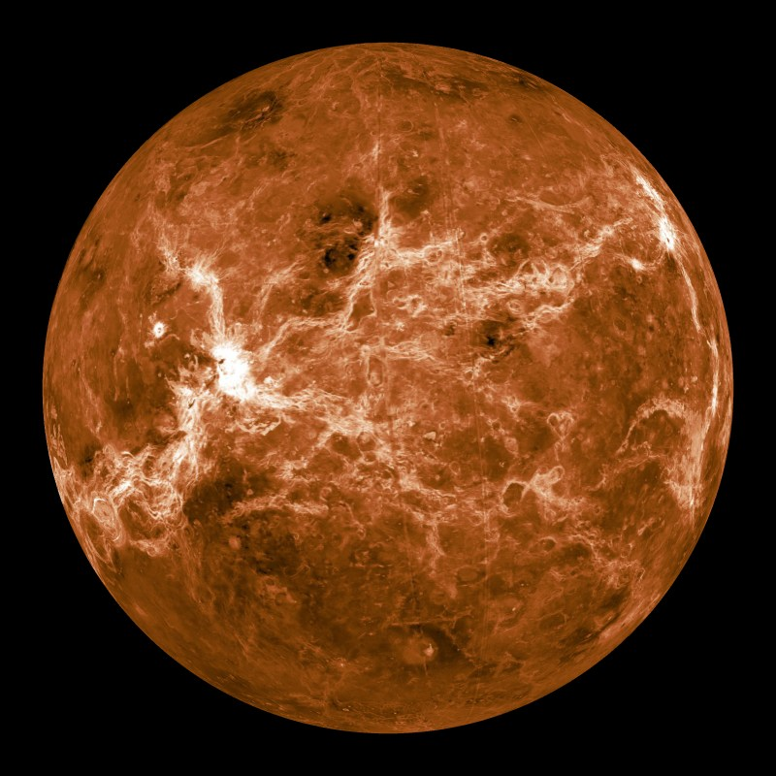
Mercury
Notes:
Instructional Approach(s): Introduce Mercury

Slide 3
Mercury
Size relative to earth: smaller than earth
Surface features: many craters and high cliffs
Atmospheric features: no atmosphere
Relative distance from the sun: closest planet to the Sun
It cannot support life
Other facts: Inner planet; has no moons; “earth-like” characteristics
Notes:
Instructional Approach(s): The teacher should read through each characteristic while the students record the information on the Planet Comparison Chart.

Slide 4
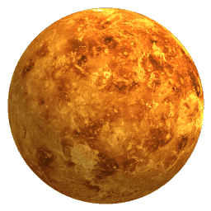
Venus
Notes:
Instructional Approach(s): Introduce Venus

Slide 5
Venus
Size relative to earth: Close to the earth’s size
Surface features: Hottest planet (can melt lead)
Atmospheric features: Contains Carbon dioxide (CO₂)
Relative distance from the sun: Second planet from the sun
It cannot support life
Other facts: Inner planet; sometimes called Earth’s twin because of its “earth-like” characteristics; a day is longer than a year due to its slow spin; spins clockwise; brightest object in the sky after the sun and moon
Notes:
Instructional Approach(s): The teacher should read through each characteristic while the students record the information on the Planet Comparison Chart.

Slide 6
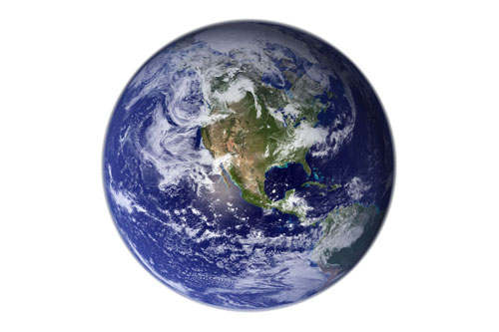
Earth
Notes:
Instructional Approach(s): Introduce Earth

Slide 7
Earth
Surface features: Has canyons, craters, mountains, volcanoes; more than 70% of the surface is covered by water
Atmospheric features: Contains Oxygen (O₂) and Nitrogen (N₂)
Relative distance from the sun: Third planet from the sun
Only planet known to support life
Other facts: Inner planet; Has one moon
Notes:
Instructional Approach(s): The teacher should read through each characteristic while the students record the information on the Planet Comparison Chart.

Slide 8
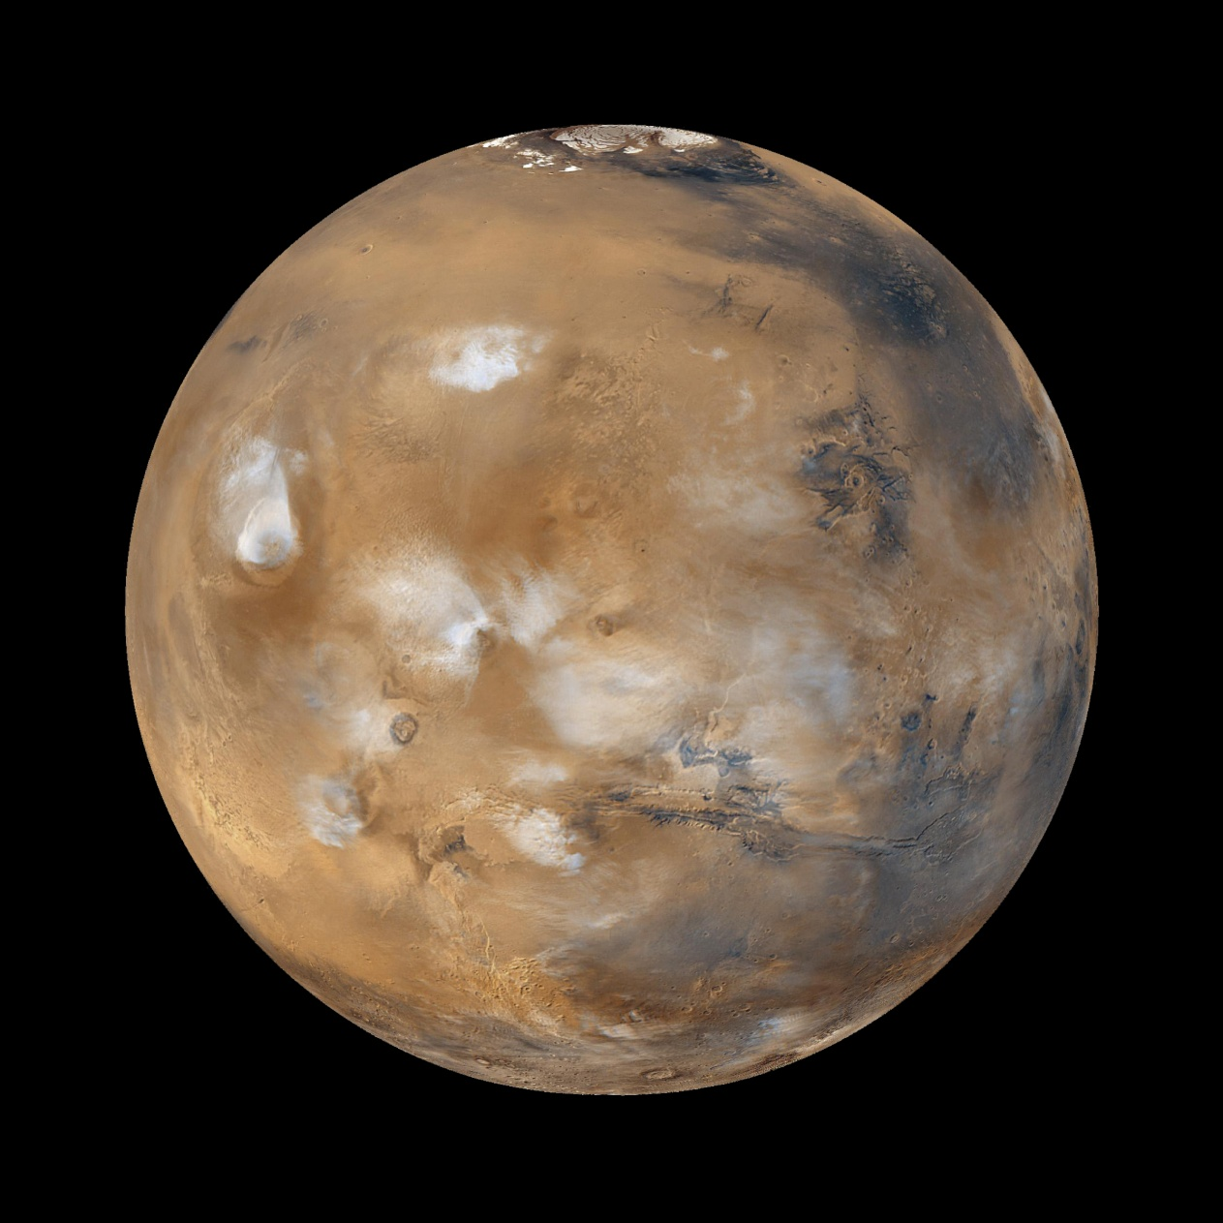
Mars
Notes:
Instructional Approach(s): Introduce Mars

Slide 9
Mars
Size relative to earth: Smaller in size than the earth
Surface features: “earth-like” characteristics; all water is frozen; once had active volcanoes
Atmospheric features: Thinner atmosphere than earth made mostly of carbon dioxide (CO₂)
Relative distance from the sun: Fourth planet from the Sun
It cannot support life
Other facts: Inner planet; called the red planet because of rusted soil; has severe dust storms at hurricane speed
Notes:
Instructional Approach(s): The teacher should read through each characteristic while the students record the information on the Planet Comparison Chart.

Slide 10
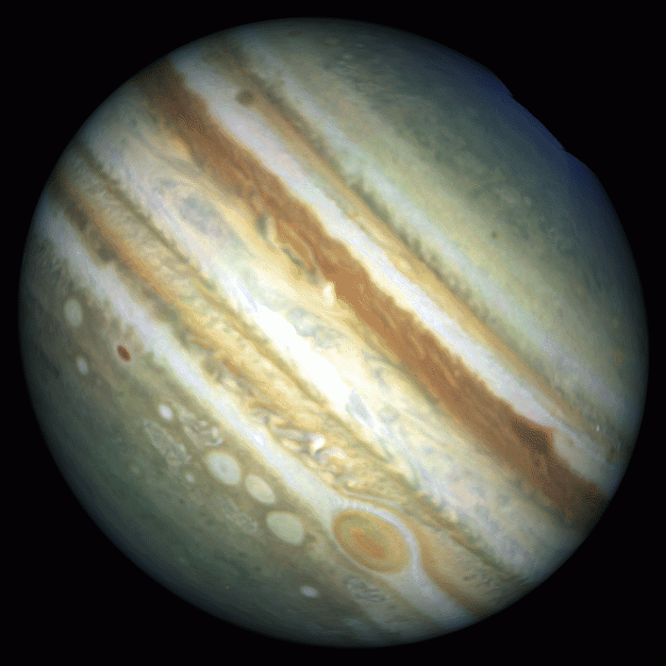
Jupiter
Notes:
Instructional Approach(s): Introduce Jupiter

Slide 11
Jupiter
Size relative to earth: Larger than the earth
Surface features: Gaseous planet
Atmospheric features: Contains mostly Hydrogen (H₂) and Helium (He)
Relative distance from the sun: Fifth planet from the Sun
It cannot support life
Other facts: Outer planet; largest planet; faint ring of dust; spins the fastest; has 63 moons; has a large red spot
Notes:
Instructional Approach(s): The teacher should read through each characteristic while the students record the information on the Planet Comparison Chart.

Slide 12
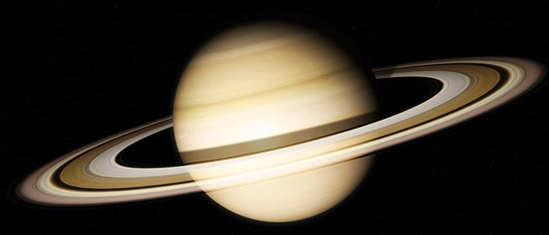
Saturn
Notes:
Instructional Approach(s): Introduce Saturn

Slide 13
Saturn
Size relative to earth: Larger than earth
Surface features: Surface is fluid; it is the least dense planet
Atmospheric features: Contains mostly Hydrogen (H₂) and Helium (He)
Relative distance from the sun: Sixth planet from the Sun
It cannot support life
Other facts: Outer planet; Gaseous planet; 1 year equals 29 ½ Earth years; Largest, most impressive ring system; Second largest planet in the solar system
Notes:
Instructional Approach(s): The teacher should read through each characteristic while the students record the information on the Planet Comparison Chart.

Slide 14
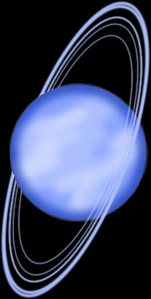
Uranus
Notes:
Instructional Approach(s): Introduce Uranus

Slide 15
Uranus
Size relative to earth: Larger than earth
Surface features: planet of ice and gas so it really does not have a surface (you would sink into the liquid icy center)
Atmospheric features: Contains mostly Hydrogen (H₂), Helium (He), and Methane (CH₄)
Relative distance from the sun: 7th planet from the Sun
It cannot support life
Other facts: Gaseous planet; Third largest planet; Tipped on its side
Notes:
Instructional Approach(s): The teacher should read through each characteristic while the students record the information on the Planet Comparison Chart.

Slide 16
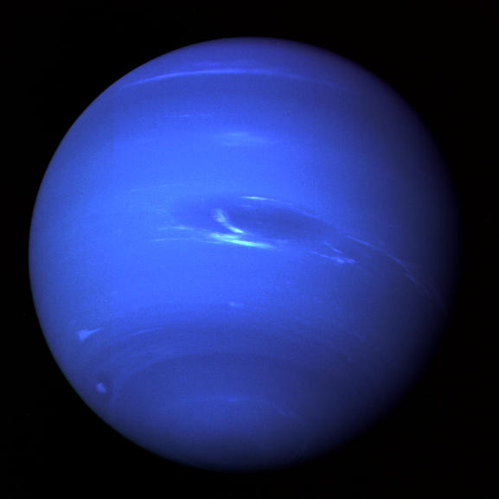
Neptune
Notes:
Instructional Approach(s): Introduce Neptune

Slide 17
Neptune
Size relative to earth: Larger than earth
Surface features: Coldest planet and has large storm systems like the Great Dark Spot; not a solid surface
Atmospheric features: Methane (CH₄)
Relative distance from the sun: 8th planet from the sun
It cannot support life
Other facts: Outer planet; Gaseous planet
Notes:
Instructional Approach(s): The teacher should read through each characteristic while the students record the information on the Planet Comparison Chart.

