Slide 1
February 26, 2019
LT: I can explain the importance of nutrients.
Warm-Up
Make a list of all the food items you consumed yesterday. Be sure to include drinks. Put a star by the items that were healthy.

Slide 2
Nutrition

Slide 3
Nutrients
Substances in food that provide energy and materials for cell development, growth, and repair.

Slide 4
Energy Needs
Your body needs energy for everyday activities. (blinking eyes, breathing, lifting backpack)
Where does the energy come from?

Slide 5
The energy comes from the foods you eat.
The amount of energy in food is measured in Calories.
Calories: is the amount of heat necessary to raise a kg of water 1°C

Slide 6
Foods vary in the amount of calories…
Hamburger 260 Cal
A serving of raw carrots 90 Cal
Slice of cheese pizza 170 Cal
Takis 140 Cal

Slide 7
6 kinds of nutrients available in food
Proteins (O)
Carbohydrates (O)
Fats (O)
Vitamins (O)
Minerals (I)
Water (I)
O: Organic nutrients; contains Carbon
I: Inorganic nutrients; does NOT contain Carbon

Slide 8
Proteins
Monomer (building block): Amino acids
Contains C, H, O, N and sometimes S
Meat, poultry, eggs, fish, peas, beans, and nuts

Slide 9
Carbohydrates
Monomer: monosaccharide (a simple sugar)
C, H, O
Are the main source of energy in your body
Pasta, veggies, fruits, bread

Slide 10
Fats/Lipids
Monomer: Fatty acids
Not soluble in water
C, H, O
Provide energy and help the body absorb vitamins
Cushion internal organs
Found in cell membrane
Stored energy

Slide 11
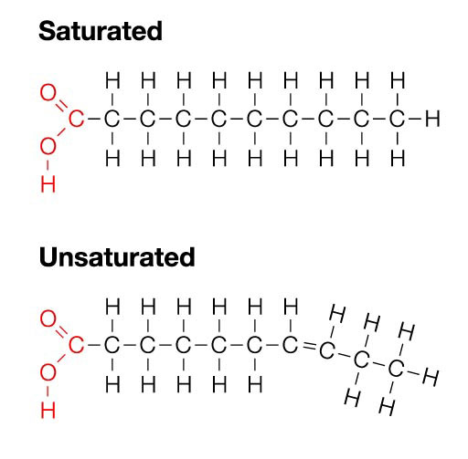
Unsaturated and saturated fats
Liquid at room temperature
Vegetable oils and fats found in seeds
Solid at room temperature
Meats, and animal products,

Slide 12
Vitamins
Organic nutrients that are needed in small quantities for growth, regulating body functions, and preventing some diseases.
Your bones need vitamin D to use calcium
Your blood needs Vitamin K in order to clot

Slide 13
Minerals
Inorganic nutrients that regulate many chemical reactions in the body.

Slide 14
Water
2/3 of your body is made up of water
Carry all nutrients through the body
Exhaled air 350 mL
Feces 150 mL
Skin (sweat) 500 mL
Urine 1500 mL

Slide 16
Create your meals for a week
 | Monday | Tuesday | Wednesday | Thursday | Friday
Breakfast Snack Lunch Snack Dinner

Slide 17
February 28, 2019
LT: I can explain the functions of an enzyme.
Warm-Up
What are the monomers for the following?
Carbohydrates
Protein
Fats/lipids

Slide 18
Digestive system

Slide 19
What is digestion?
The process that breaks food down into small molecules so that they can be absorbed and moved into the blood.
From the blood they are transported across the cell membrane to be used by the cell.

Slide 20
2 parts of Digestion
1. Mechanical digestion- when food is chewed, mixed, and churned.
2. Chemical digestion- when chemical reactions break down large molecules of food into smaller ones.

Slide 21
Enzymes
A protein that speeds up the rate of a chemical reaction.
Reduce the amount of energy required for a reaction to begin
** If some enzymes did not exist it would take the reaction a longer time to start or it may not start at all.

Slide 22
Enzymes -Sucrase (helps break down sucrose) -Lactase (helps breaks down lactose)
Usually end in “ASE”
Amylase is a enzyme that is produced in the glands near your mouth, it breaks down Carbohydrates
Pepsin breaks down complex proteins and it is found in the stomach
Aid in more than just digestion: involved in energy production, building your body, blood clotting etc.
WITHOUT ENZYMES THE CHEMICAL REACTIONS IN YOUR BODY WOULD NOT HAPPEN IN YOUR BODY IN FACT YOU WOULD NOT EXIST.

Slide 23
Enzyme substrate complex

Slide 24
Factors affecting enzyme activity
Temperature
pH

Slide 25
Temperature & ph
High temperatures are the most dangerous reactions & denature enzymes
Most enzymes like near neutral pH (6 to 8)

Slide 26
February 28, 2019
LT: I can explain the digestion process.
Warm-Up
Draw the enzyme substrate complex. Why is it considered to be a lock and key model?

Slide 27
Organs that aid in digestion
Major organs
Accessory organs (important in mechanical and chemical digestion)
Mouth
Esophagus
Stomach
Small intestine
Large intestine
Rectum
Anus
Tongue
Teeth
Salivary glands
Liver
Gallbladder
pancreas

Slide 28
The mouth
Mechanical digestion begins in the mouth (chew on food with teeth and mix it with tongue)
Chemical digestion begins with a watery substance called SALIVA
Saliva is mostly water and contains some enzymes to break down food.

Slide 29
The esophagus
Covers the windpipe to prevent food from entering. What if this did not happen?
A muscular tube that transport food to the stomach
Made of smooth muscles (move downward in a squeezing action)
Peristalsis: a muscle contraction that moves in a down squeezing motion
** move food through the entire digestive tract.

Slide 31
The stomach
A muscular bag that expands when food enters
Mechanically Food is mixed by peristalsis
Chemically food is mixed with enzymes and strong digestive solutions.
Contains HCl (Hydrochloric acid)- destroys bacteria that is not supposed to be present
food is changed to a water liquid called chyme
Chyme goes to small intestines

Slide 32
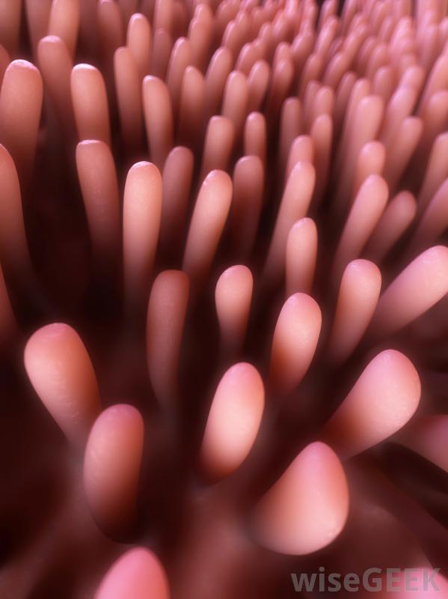
Small intestine
Chyme enters the duodenum
Bile ( a green liquid that breaks down fat) is produced by the liver
Pancreas makes insulin, a hormone that allows glucose to pass to the cells from the blood stream
ABSORPTION of food
Villi: Small finger like projections that aid in absorption

Slide 33
The Large Intestine
ABSORPTION of water
Keeps large amounts of water in your body
The mass becomes more solid
Muscles release waste from body in the form of feces

Slide 34
https://www.youtube.com/watch?v=VwrsL-lCZYo

Slide 35
March 1, 2019
LT: I can distinguish and analyze the components of the Skeletal system, Muscular system, Integumentary system, and the Digestive system.
Warm-Up
Which would dissolve the fastest?
Sugar cube
Granulate sugar
Grounded sugar particles
Why is it important to chew your food thoroughly?

Slide 36
LT: I can distinguish and analyze the components of the Skeletal system, Muscular system, Integumentary system, and the Digestive system.
Warm-Up
What is the overall function for the following body systems:
Skeletal system
Muscular system
Integumentary system
Digestive system

Slide 37
LT: I can distinguish and analyze the components of the Skeletal system, Muscular system, Integumentary system, and the Digestive system.
Warm-Up
Study for the Mini-Unit Test

