Slide 1
Where is the Earth’s water located?
Explain that a large portion of the Earth’s surface is water, consisting of oceans, rivers, lakes, underground water, and ice.
Notes:
Instructional Approach(s): The teacher should introduce the lesson essential question and the standard that aligns to the essential question.

Slide 2
How Wet is our Planet? Demonstration or Water on Earth Demonstration
Notes:
Instructional Approach(s): Select one of the activating strategies linked on the resource page

Slide 3
"Water, Water, Everywhere...." You've heard the phrase, and for water, it really is true.
Earth's water is (almost) everywhere: above the Earth in the air and clouds, on the Earth as rivers, oceans, ice, inside the Earth in the top few miles of the ground. Water is even in living things.
Notes:
Instructional Approach(s): The teacher should present the information on the slide.

Slide 4
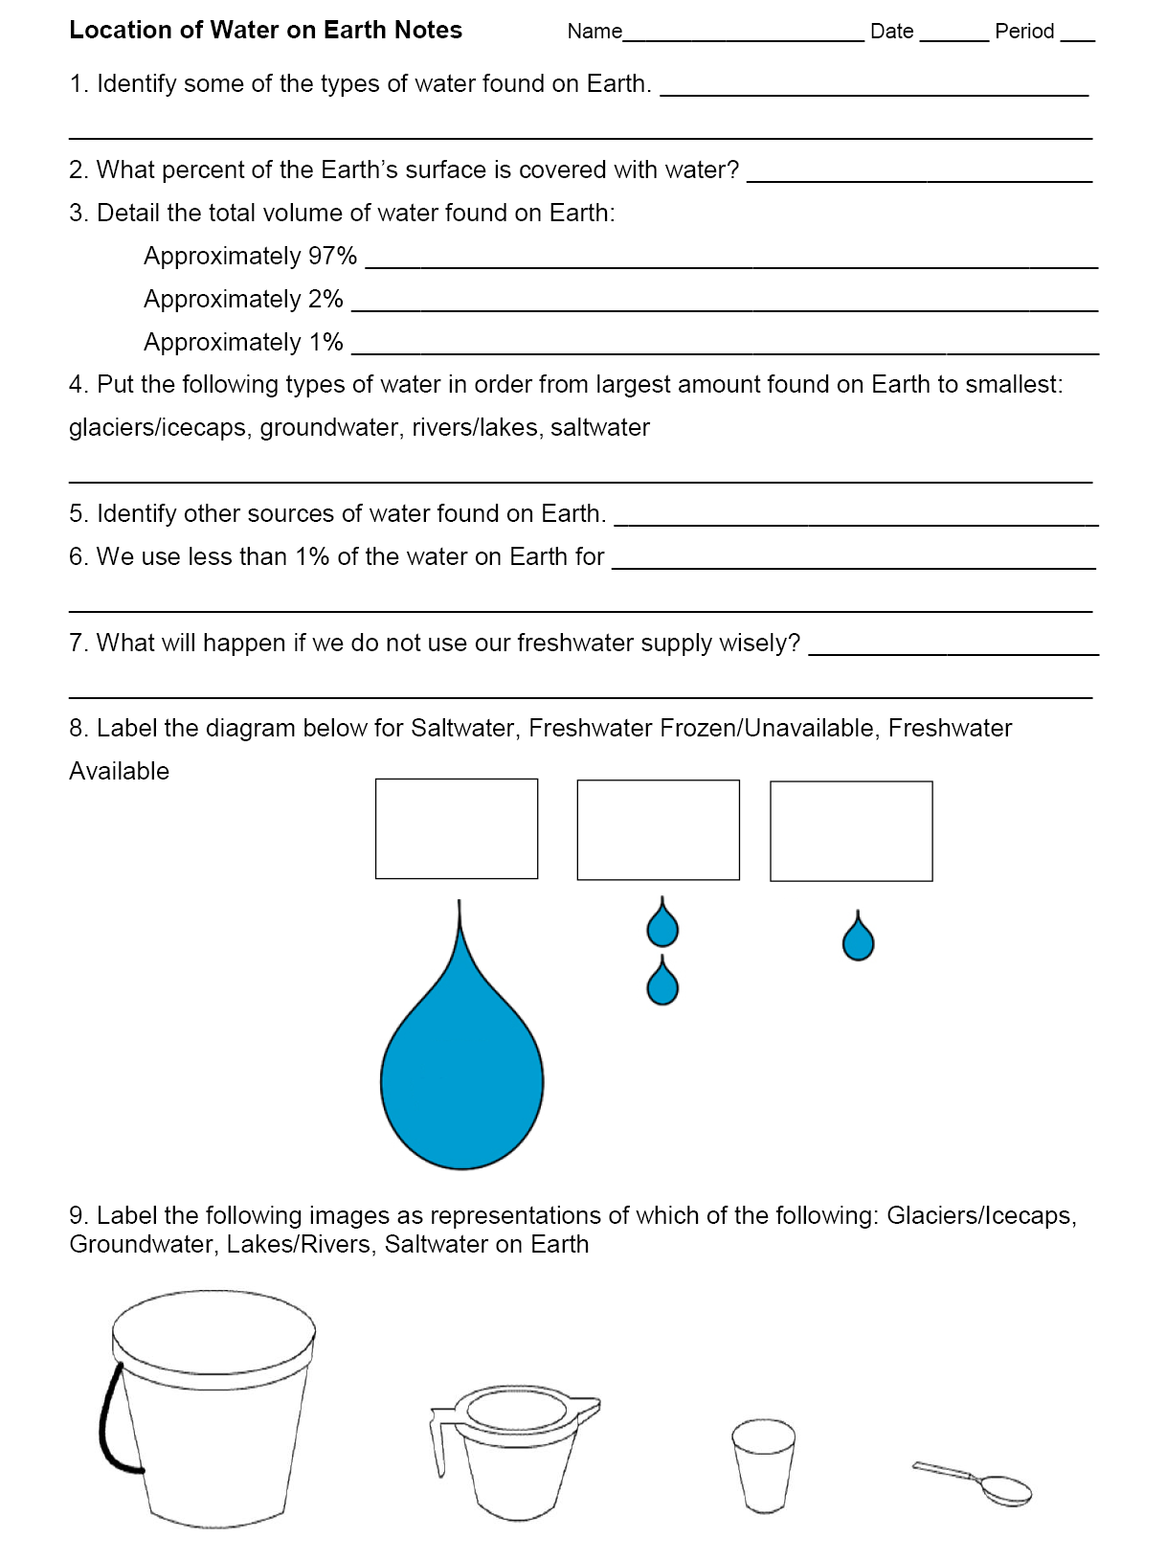
Use your notes to record important information from the lesson
Notes:
Instructional Approach(s): The teacher should give each student a copy of the Location of Water on Earth Notes [linked on the resource page] to record important information during the lesson.

Slide 5
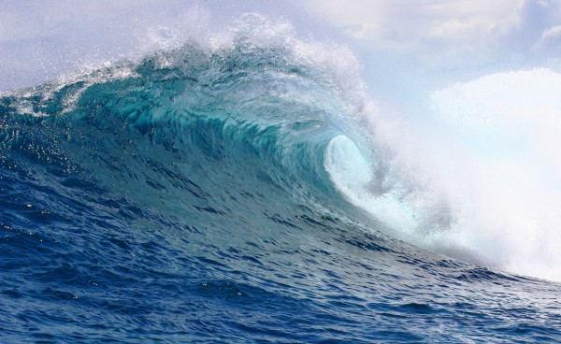
Types of Water on Earth:
Saltwater
Notes:
Instructional Approach(s): The teacher should present the information on the slide while the students record the important information on their notes.

Slide 6
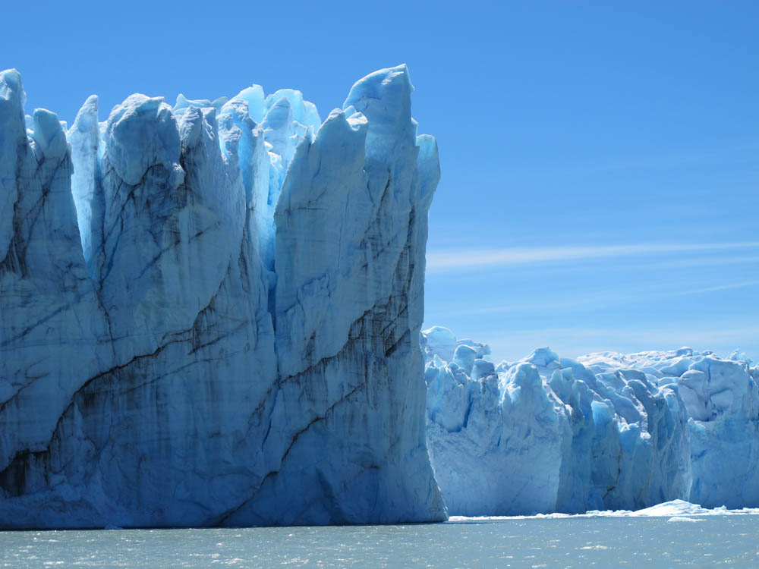
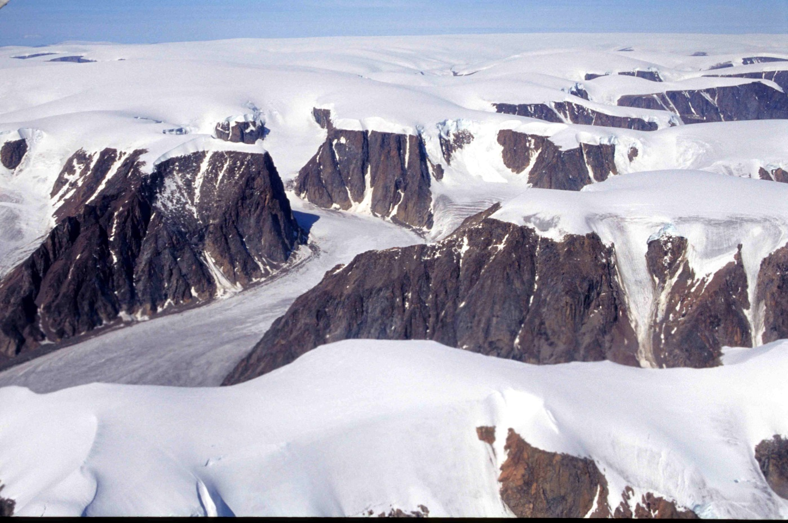
Types of Water on Earth: Glaciers & Ice Caps
Notes:
Instructional Approach(s): The teacher should present the information on the slide while the students record the important information on their notes.

Slide 7
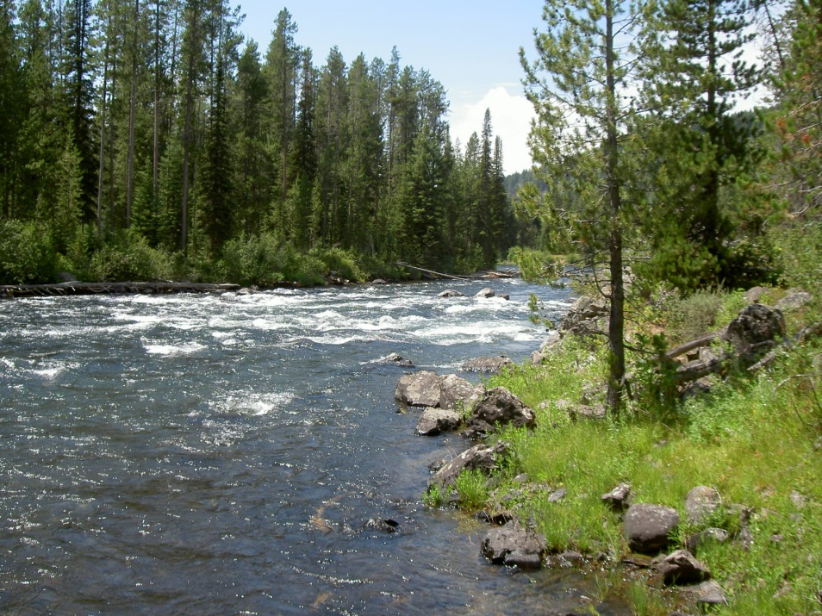
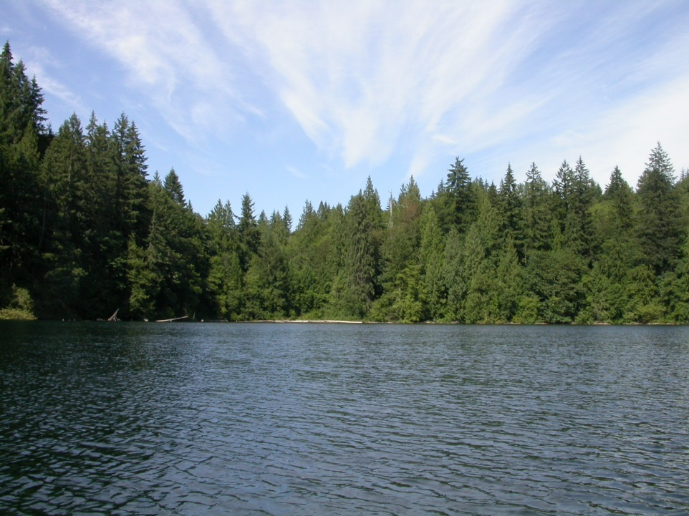
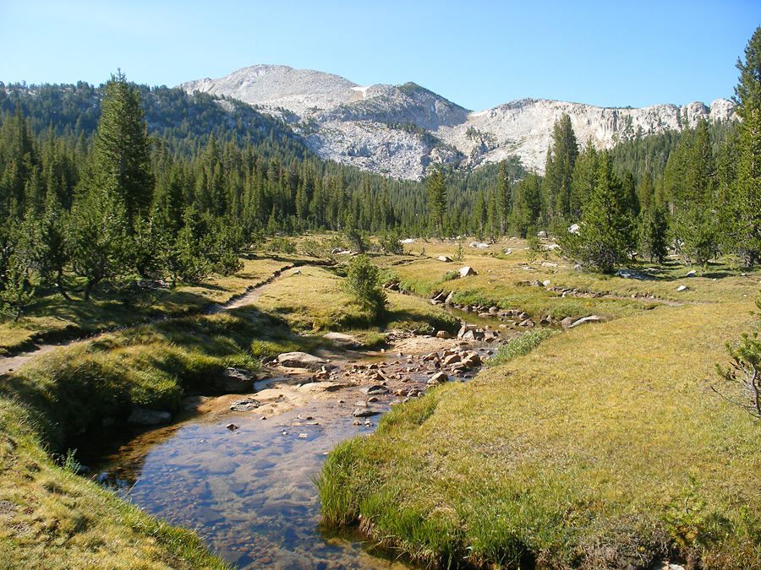
Types of Water on Earth:
Freshwater
River
Lake
Stream
Notes:
Instructional Approach(s): The teacher should present the information on the slide while the students record the important information on their notes.

Slide 8
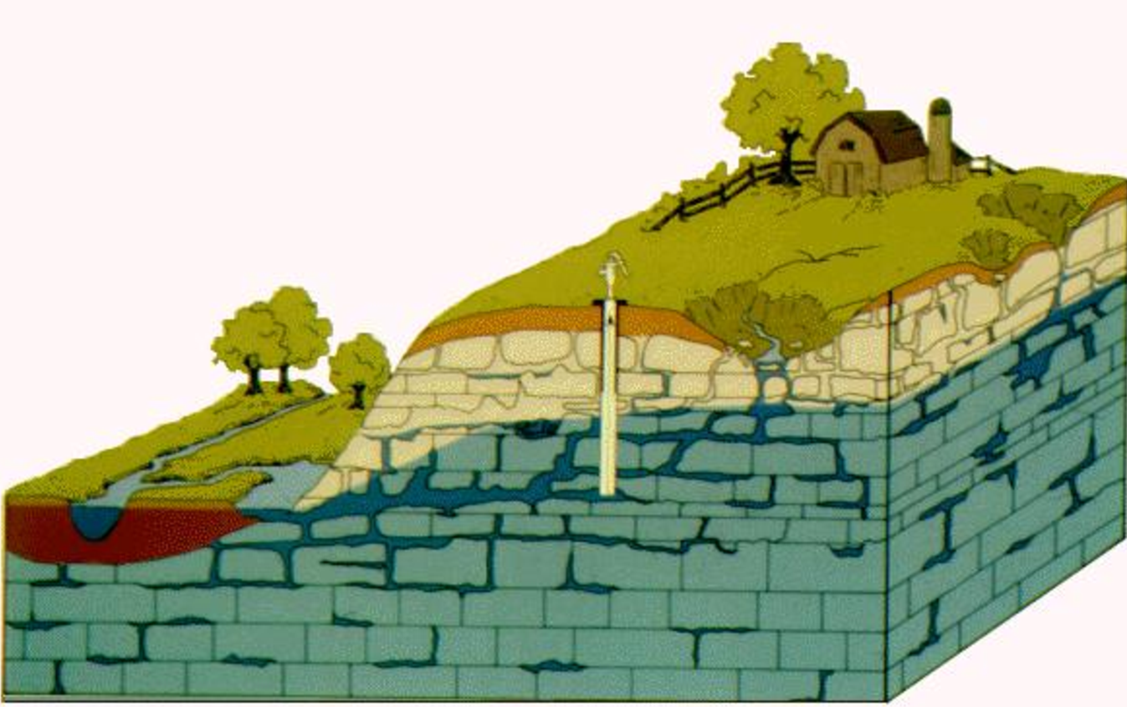
Types of Water on Earth:
Groundwater
Groundwater occurs as a liquid resource that is dispersed through numerous holes, pores, fractures and cavities in bodies of rock or sediment
Notes:
Instructional Approach(s): The teacher should present the information on the slide while the students record the important information on their notes.

Slide 9
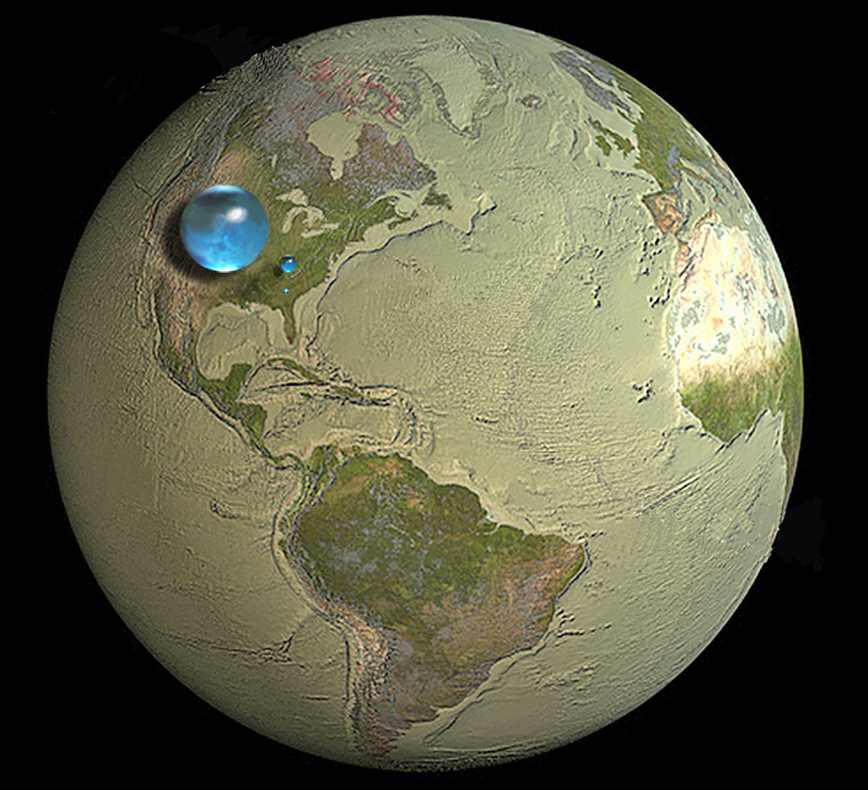
The blue spheres represent the relative amounts of Earth's water in comparison to the size of the Earth.
Are you surprised that these water spheres look so small? They are only small in relation to the size of the Earth.
Overall, it shows that in comparison to the volume of the globe the amount of water on the planet is very small.
Notes:
Instructional Approach(s): The teacher should present the information on the slide.

Slide 10
The largest sphere represents all of Earth's water.
The sphere includes all the water in the oceans, ice caps, lakes, and rivers, as well as groundwater, atmospheric water, and even the water in you, your dog, and your tomato plant.
Notes:
Instructional Approach(s): The teacher should present the information on the slide.

Slide 11
How much of the total water is fresh water, which people and many other life forms need to survive?
The blue sphere over Kentucky represents the world's liquid fresh water (groundwater, lakes, swamp water, and rivers).
Notes:
Instructional Approach(s): The teacher should present the information on the slide.

Slide 12
Do you see the "tiny" bubble over Atlanta, Georgia?
That one represents fresh water in all the lakes and rivers on the planet.
Most of the water people and life on earth need every day comes from these surface-water sources.
Notes:
Instructional Approach(s): The teacher should present the information on the slide.

Slide 13
Water on the Earth
About 71% of the earth’s surface is covered with water.
Of the total volume of water on Earth:
97% is saltwater
2% is freshwater frozen in ice caps and glaciers
1% is fresh water in lakes and streams, groundwater, and water vapor in the atmosphere
In general, most of the earth’s water is located in the oceans as saltwater . Most of the freshwater on Earth is located in glaciers and ice caps. Lesser amounts are found in atmospheric moisture, rivers, lakes, streams, and groundwater.
Most of the freshwater on Earth is located in glaciers and ice caps.
Notes:
Instructional Approach(s): The teacher should present the information on the slide while the students record the important information on their notes.

Slide 14
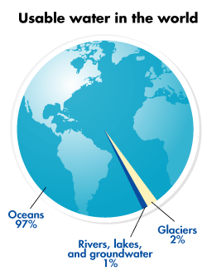
Notes:
Instructional Approach(s): The teacher should use the graph on the slide to illustrate the amount of usable water in the world.

Slide 15
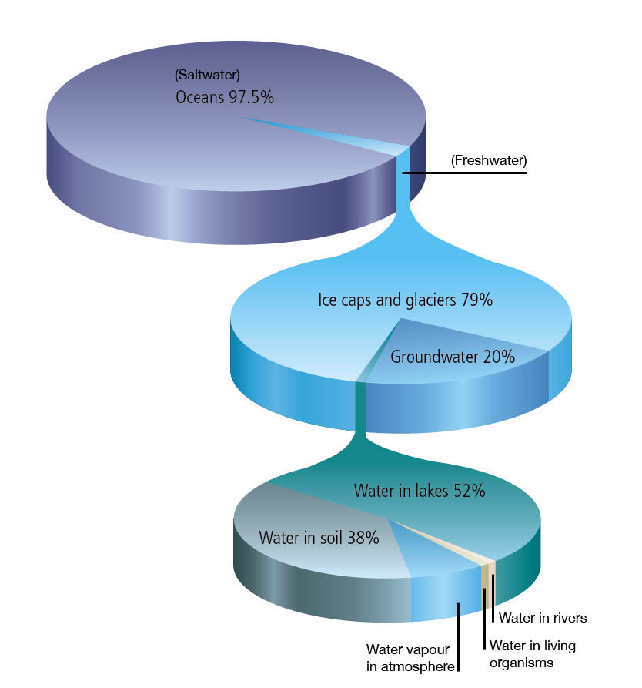
Notes:
Instructional Approach(s): The teacher should use the graph on the slide to illustrate the amount and types of water on the earth.

Slide 16
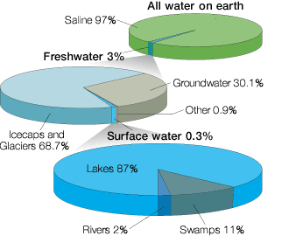
Notes:
Instructional Approach(s): The teacher should use the graph on the slide to illustrate the amount and types of water on the earth.

Slide 17
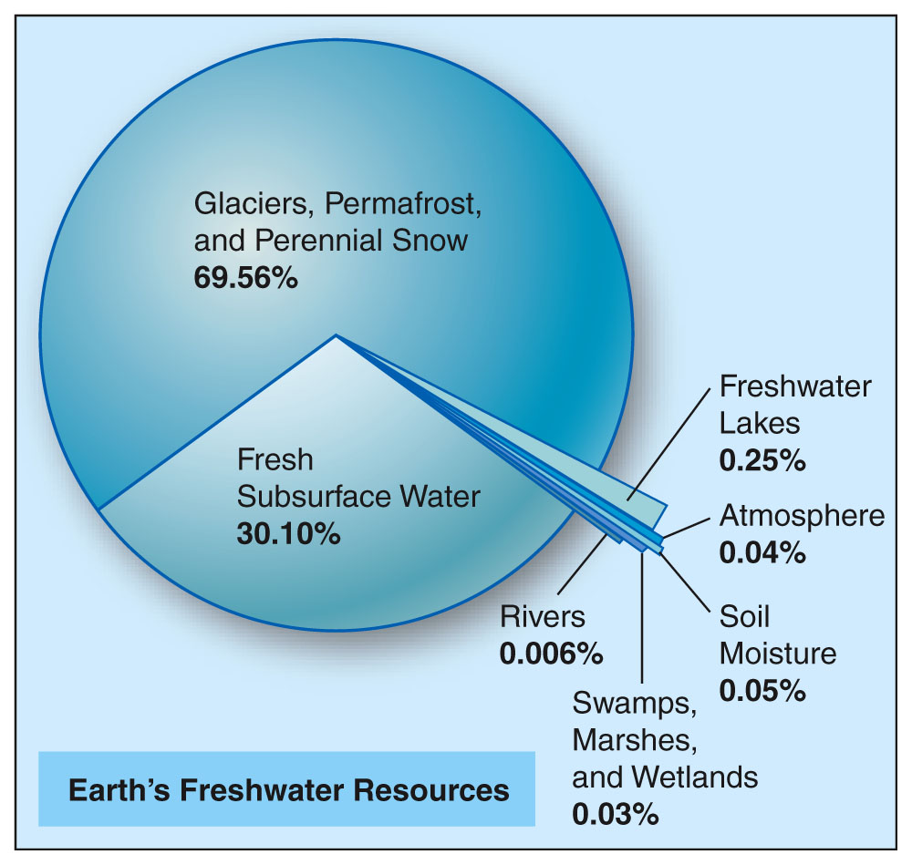
Notes:
Instructional Approach(s): The teacher should use the graph on the slide to illustrate the amount and types of water on the earth.

Slide 18
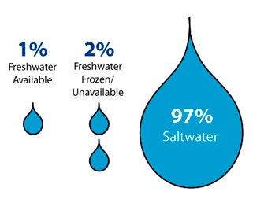
Notes:
Instructional Approach(s): The teacher should present the information on the slide while the students record the important information on their notes.

Slide 19
Water on the Earth
Water is not evenly distributed, and most of it is unsuitable for drinking.
We use less than 1% of the water on Earth for drinking and personal hygiene. We also use this fresh water for agriculture, fisheries, transportation, heating and cooling, manufacturing, and many other purposes.
Unless we use our freshwater supply wisely, rivers, lakes and groundwater can be depleted or polluted, becoming unusable or unsuitable for life.
Notes:
Instructional Approach(s): The teacher should present the information on the slide while the students record the important information on their notes.

Slide 20
Label the following images as representations of which of the following: Glaciers/Icecaps, Groundwater, Lakes/Rivers, Saltwater on Earth
Notes:
Instructional Approach(s): The students should label the images on their notes as representations of the amounts/types of water on the earth’s surface. The teacher should walk around monitoring and redirecting students as needed. Do not give more than 1 minute for students to label the representations. The teacher should ask students to compare their responses with another student. Go over the answers with the class.

Slide 21
Summarizing Strategy
Draw your own diagram illustrating the different amounts of water on the Earth’s surface. Use the following: Saltwater, Glaciers/Icecaps, Groundwater, Lakes/Rivers, Other.
Your drawings do not have to be to scale. Make general comparisons similar but not the same as the one below.
Notes:
Instructional Approach(s): Each student should complete the summarizer. The teacher should use the summarizer to determine the level of student mastery and if differentiation is needed.

