Slide 1
March 12, 2018
LT: I can identify layers of the Earth.
Warm-Up
How would you explain the rock cycle to a friend?

Slide 2
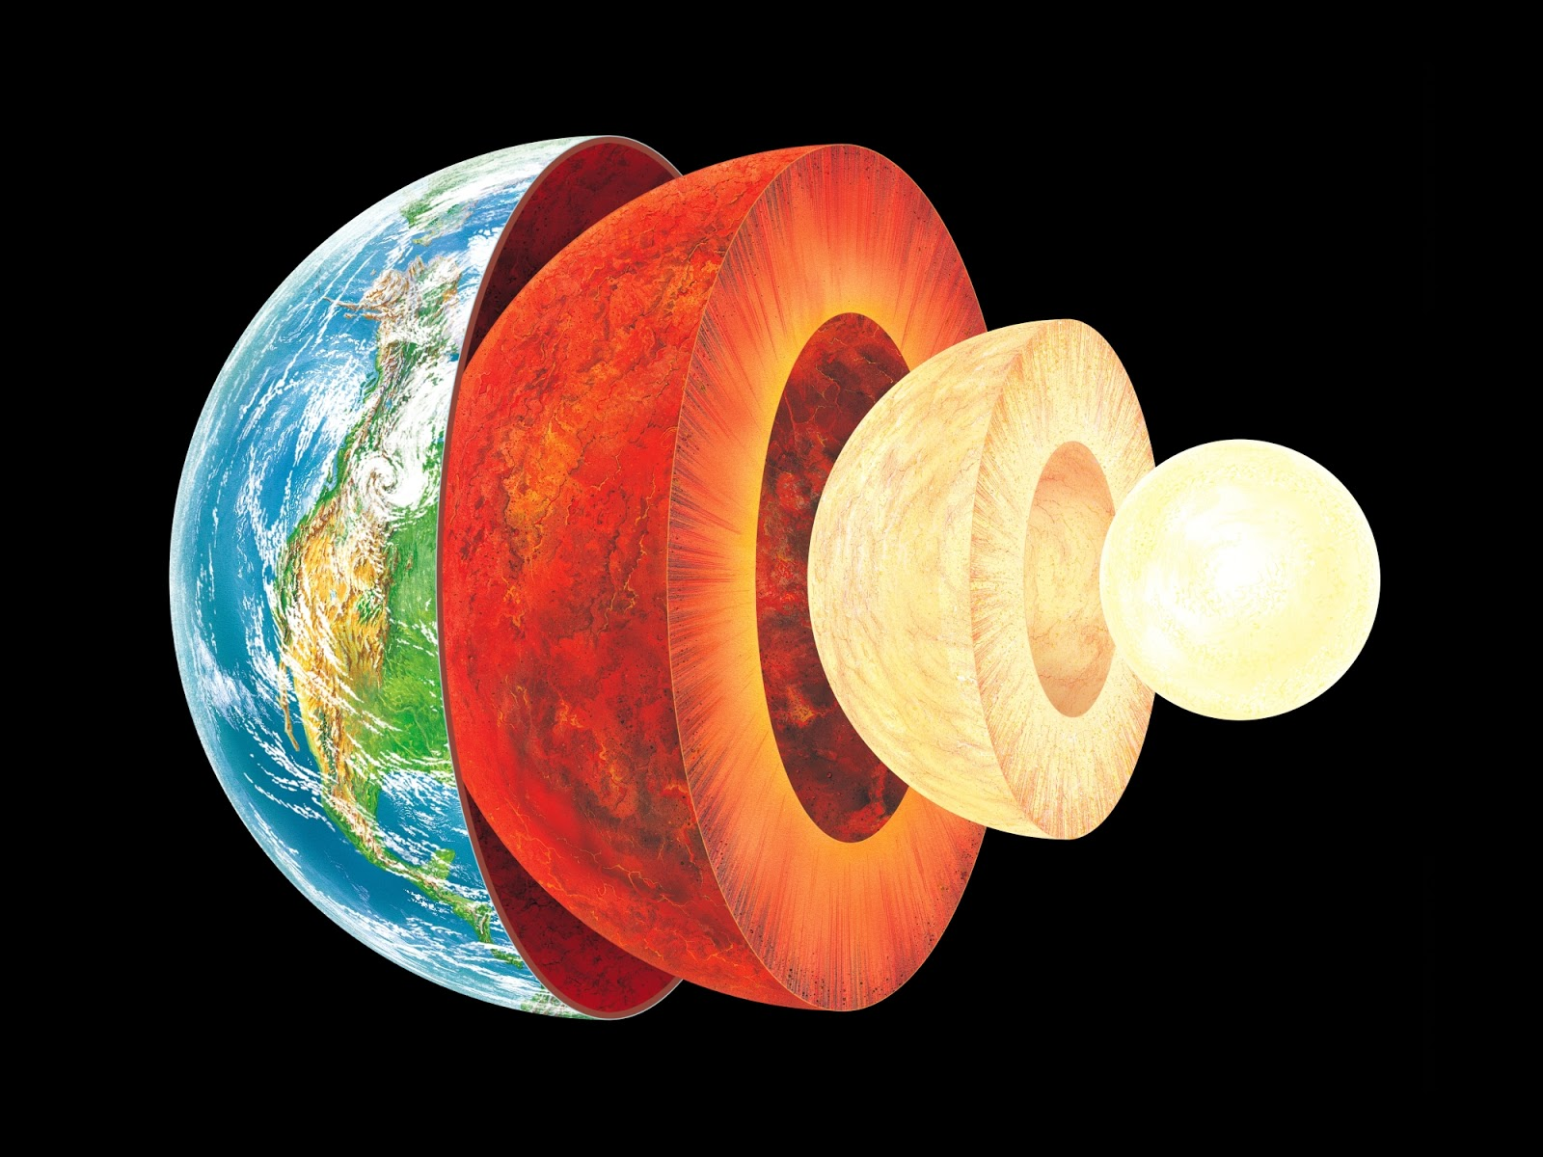
Layers of the Earth

Slide 3
March 14, 2018
LT: I can identify layers of the Earth.
Warm-Up
What did you learn while doing the webquest?

Slide 4
Watch the movie trailer for Journey to the Center of the Earth. Identify characteristics that you think are true and those you think are not true. Be prepared to share.
https://www.youtube.com/watch?v=rQx2wLyagk4

Slide 5
Essential Question: How are layers of the Earth different from one another?
Standard:
S6E5a. Compare and contrast the Earth’s crust, mantle, and core including temperature, density, and composition.

Slide 6
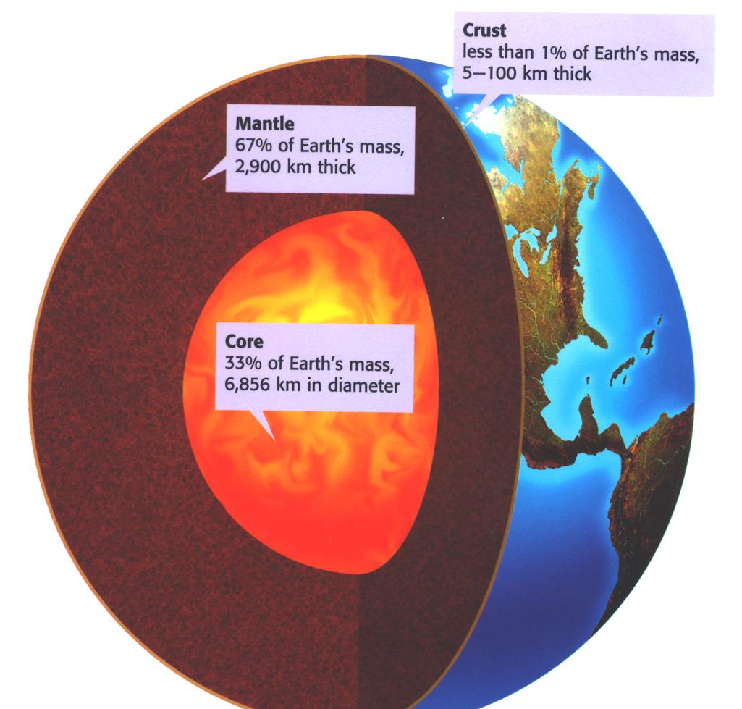
The Earth is made up of 3 main layers:
Crust
Mantle
Core

Slide 7
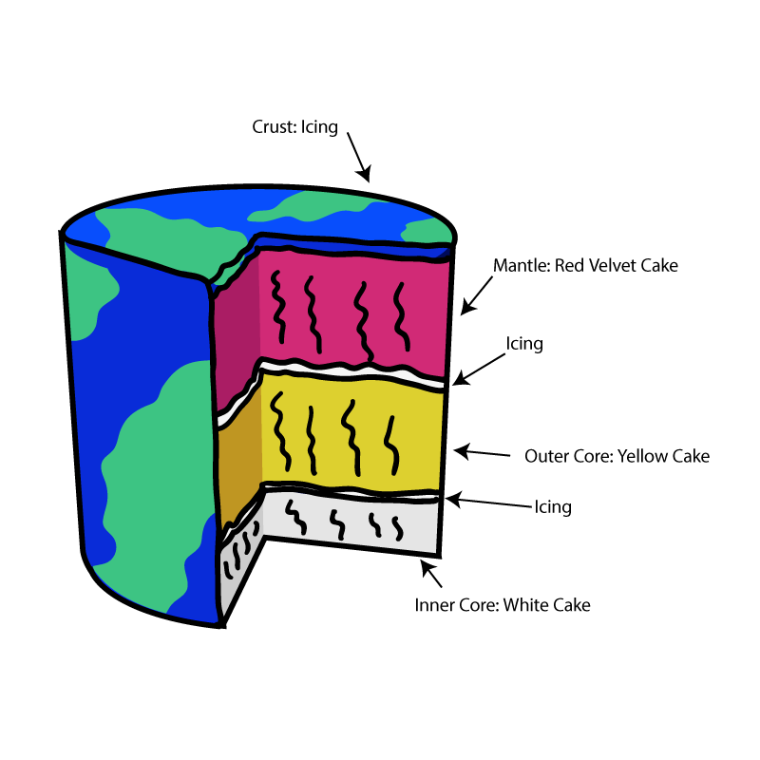
Think of the layers of the Earth like the layers of a cake.

Slide 8
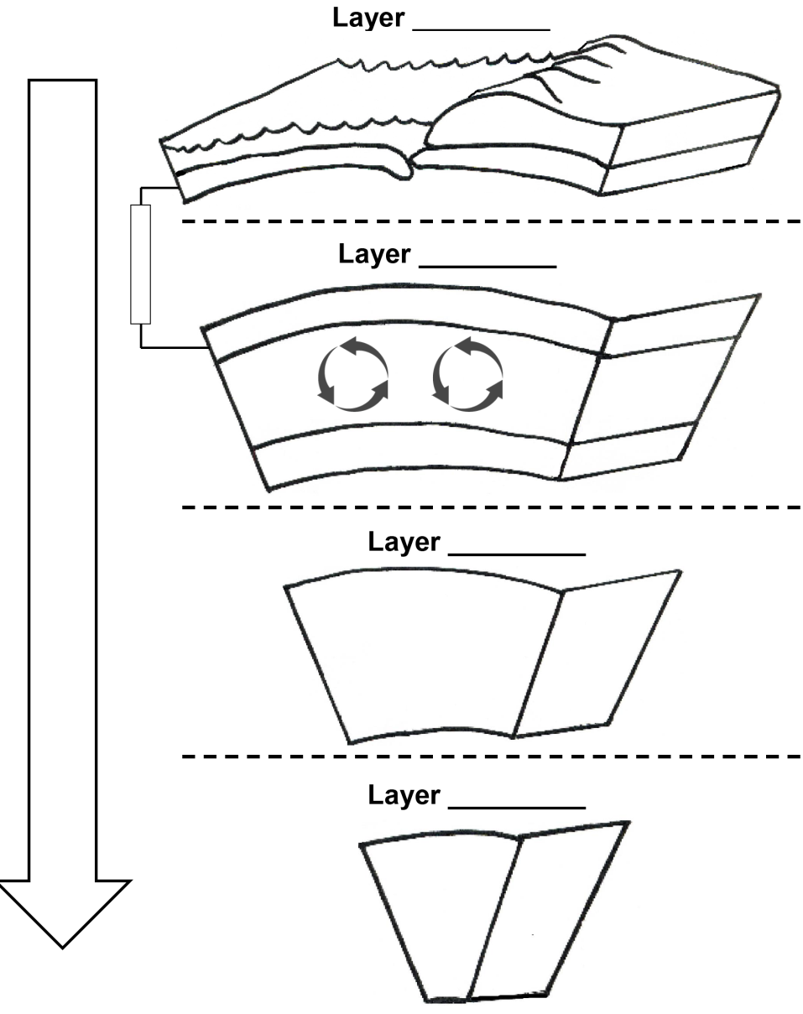
Use the Layers of the Earth Foldable to take notes

Slide 9
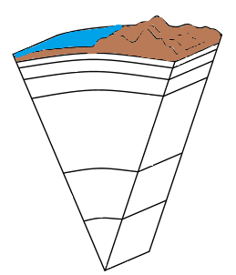
Crust
Ocean
Land
Oceanic Crust
Continental Crust

Slide 10
Crust
Ocean
Land
Oceanic Crust
Continental Crust
Thinnest layer of the Earth that ranges from only 2 miles in some areas of the ocean floor to 75 miles deep under mountains
Made up of large amounts of silicon and aluminum
Two types of crust: oceanic crust and continental crust
Composed of plates on which the continents and oceans rest
Notes:
In depth teaching about the plates and their movement will occur in the next essential question

Slide 11
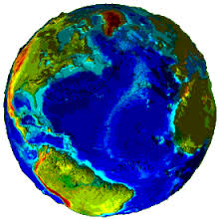
The Earth’s crust is like the skin of an apple. Turn to an elbow partner and discuss why this statement is true. Next, come up with another example.

Slide 12
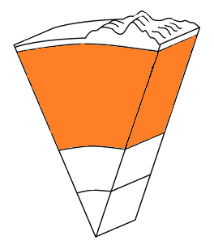
Mantle
Upper Mantle
Convection Currents
Middle Mantle
Lower Mantle

Slide 13
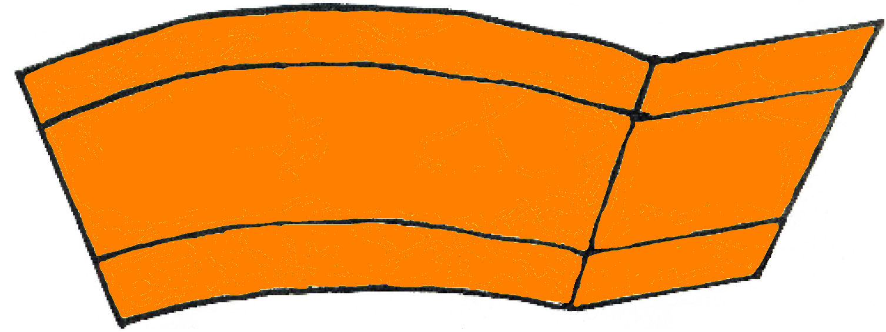
Mantle
Upper Mantle
Convection Currents
Middle Mantle
Lower Mantle
Solid but capable of flow (like hot asphalt or fudge)
Thickest layer of the Earth (making up 70% of the Earth’s mass)
The hot material (magma) in the mantle rises to the top of the mantle, cools, then sinks, reheats, and rises again. These convection currents cause changes in the Earth’s surface
Notes:
The movement of the lithospheric plates and the convection currents will be covered more in-depth during the next essential question.

Slide 14
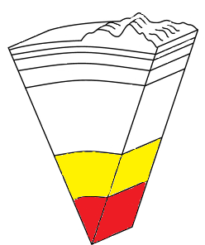
Core
Outer Core
Inner Core

Slide 15
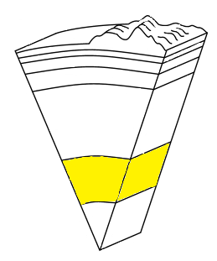
Outer Core
Molten (liquid) metal that is about 4,700°C (8,500°F)
Located about 1,800 miles beneath the crust and is about 1,400 miles thick
Composed of the melted metals nickel and iron

Slide 16
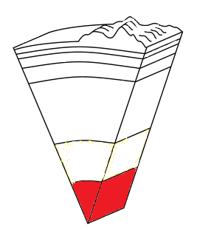
Inner Core
Solid sphere composed mostly of iron
It is believed to be as hot as 6,650°C (12,000°F)
Heat in the core is probably generated by the radioactive decay of uranium and other elements
It is solid because of the pressure from the outer core, mantle, and crust compressing it tremendously

Slide 17
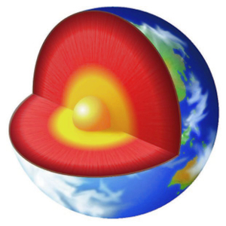
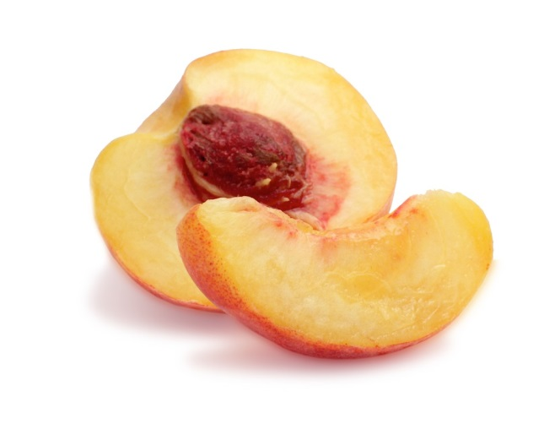
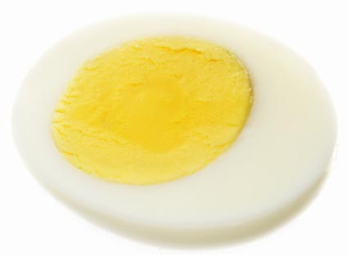
The Earth is like a peach or a boiled egg. Turn to a seat partner and discuss these analogies. Come up with another analogy and be prepared to share.

Slide 18
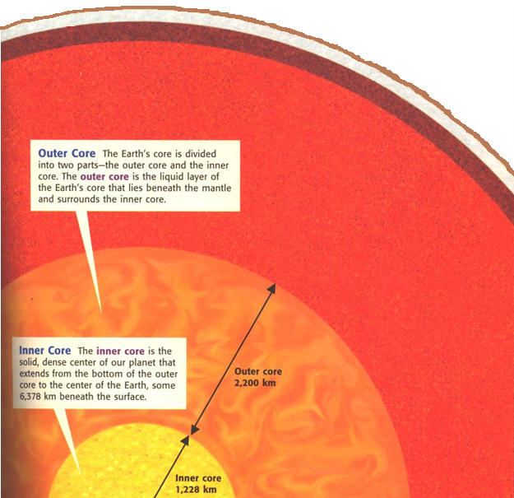
Crust
Mantle
Outer Core
Liquid
Lithosphere – Crust and Upper Layer of the Mantle
Layer of the Mantle (asthenosphere) that consists of hot rock of tar-like consistency, which slowly moves
Inner Core Solid

Slide 19
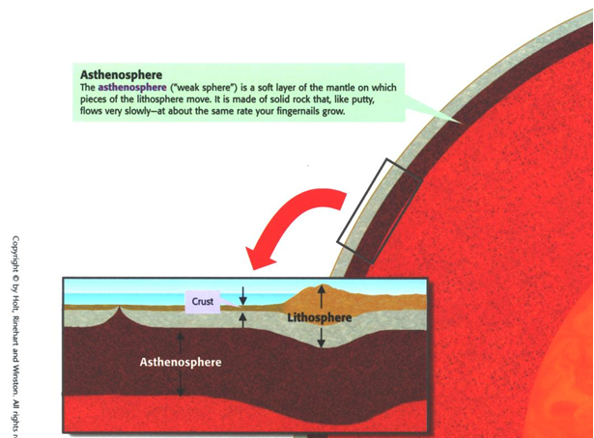

Slide 20
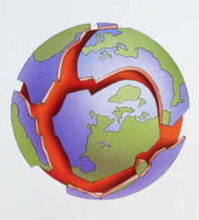
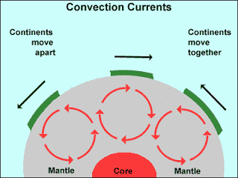
The lithosphere (crust and upper mantle) is divided into separate plates which move very slowly in response to the “convecting” part of the mantle.

Slide 21
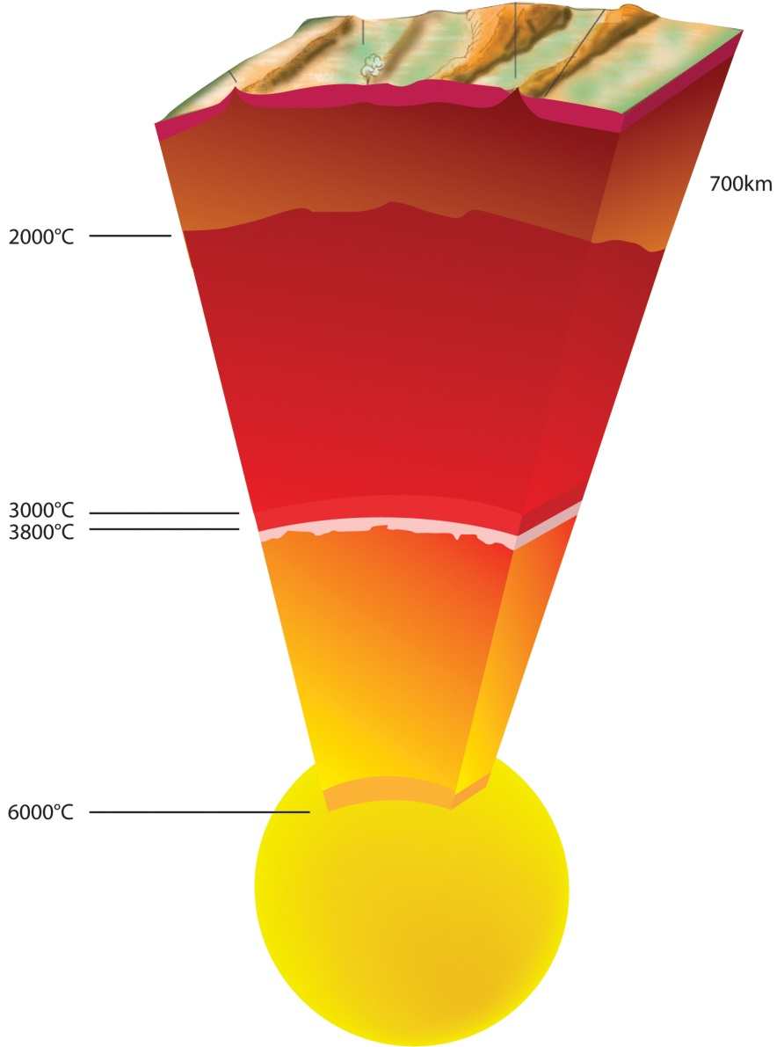
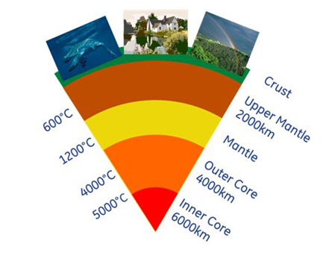
What do these two images tell us about the layers of the Earth?

Slide 22
Temperature increases as depth increases

Slide 23
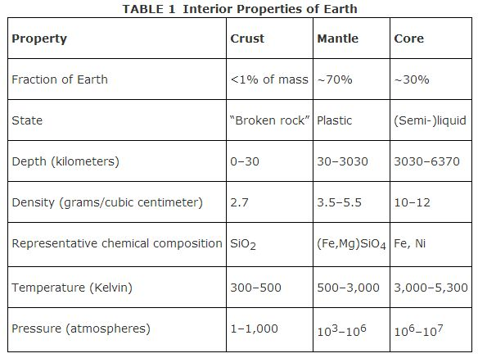
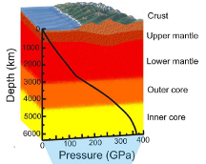
Look at the information in the graph and table below. What’s the relationship between depth and density/pressure?

Slide 24
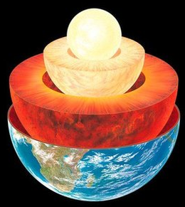
Density and Pressure increase as depth increases

Slide 25
Add this statement to the arrow going down on your foldable.
Temperature,
Density and Pressure increases as depth increases

Slide 26
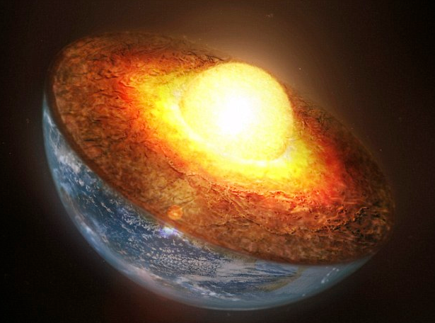
Which layer of the Earth has the greatest temperature, pressure, and density?
Core

Slide 27
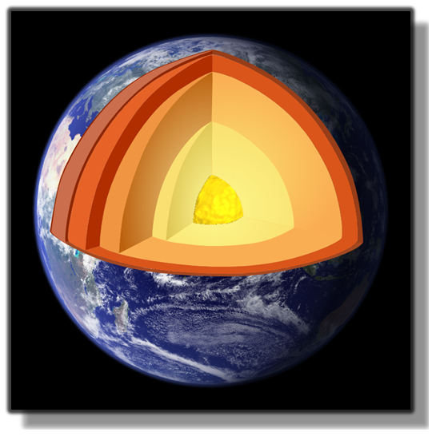
The earth is layered with a lithosphere (crust and uppermost mantle), convecting mantle, and a dense metallic core.
Summary
Pressure, temperature, and density increases as depth increases.
http://www.learner.org/interactives/dynamicearth/structure.html

Slide 28
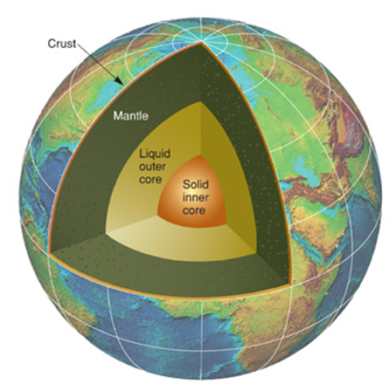
Mr. Lee’s Layers of the Earth Rap

Slide 29
Layers of the Earth Review

Slide 30
Summarizing Strategy

