Slide 1
December 12, 2017
LT: I can present my science fair project.
Warm-Up
Summarize your entire science fair project. Use your summarization to prepare for the interview.

Slide 2
January 4, 2018
Read the event described below, identify on your paper how many different waves were present.
Imagine that your family has just returned home from a day at the beach. You had fun playing in the ocean under a hot sun. You put some cold pizza in the microwave for dinner, and you turn on the radio. Just then, the phone rings. It’s your friend calling to ask about homework.

Slide 4
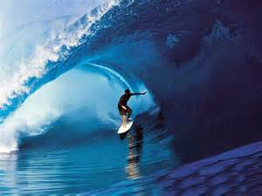
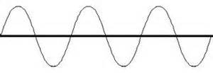
What is a WAVE?
A wave is any disturbance that transfers energy through matter or space.
Once the wave has moved, the disturbance is gone.
The energy carried by ocean waves
can break rocks.

Slide 5
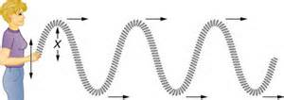
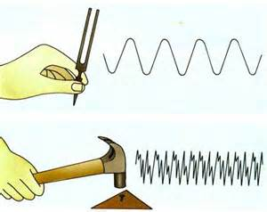
What is a WAVE?
Waves are created when a source creates a vibration.

Slide 6
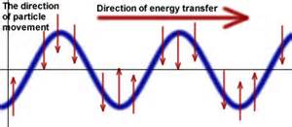
What is a WAVE?
Waves are moving energy!
The energy causes materials to vibrate.

Slide 7
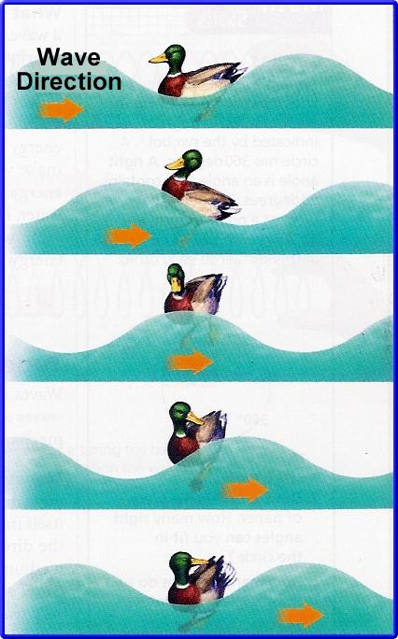
What is a WAVE?
Waves only carry energy, not matter!

Slide 8
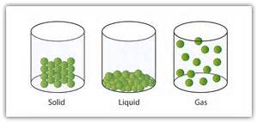
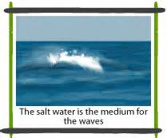
How do waves travel?
The matter through which a wave travels is called a MEDIUM.

Slide 9
Transverse Waves:
waves in which the particles vibrate in an up and down motion
ex: light waves
http://www.youtube.com/watch?v=UHcse1jJAto&feature=player_detailpage#t=8
Notes:
not sure?

Slide 10
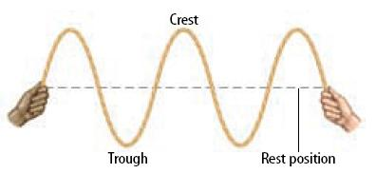
The crest is the highest point on a transverse wave.
The trough is the lowest point on a transverse wave.
The rest position of the wave is called the node or nodal line.

Slide 11
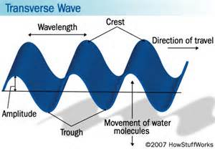
Transverse Wave
Notes:
copied

Slide 12
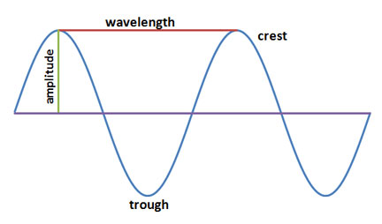
Transverse Wave
rest position
copy this transverse wave into your notes!
Notes:
not sure?

Slide 13
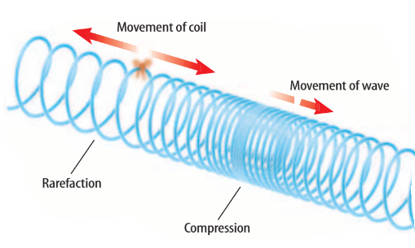
Longitudinal Waves:
waves in which the particles vibrate back and forth in compressional pulses
ex: sound waves
Carry energy along the wave
http://www.youtube.com/watch?v=aguCWnbRETU&feature=player_embedded
Notes:
copied

Slide 14
Longitudinal Wave
rarefaction
copy this longitudinal wave into your notes!
Notes:
not sure?

Slide 15
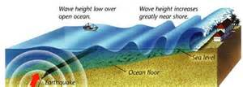
Mechanical Waves
Mechanical Waves need a medium to travel through.
Examples of Mechanical Waves:
sound
water
ropes
earthquakes
tsunami waves
Mechanical Waves can be either Transverse or Longitudinal

Slide 16
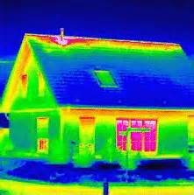
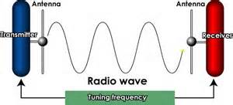
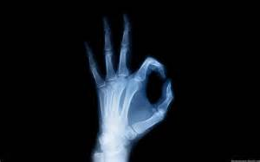
Electromagnetic Waves
Electromagnetic Waves do
NOT need a medium to travel
through.
Examples of Electromagnetic Waves:
x-rays
radio waves
infrared radiation
microwaves
visible light

Slide 17
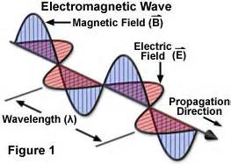
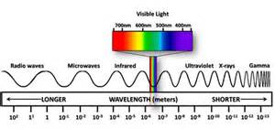
Electromagnetic Waves
Electromagnetic Waves are ALWAYS transverse waves.

Slide 18
January 9, 2017
Explain the differences between longitudinal and transverse waves. Remember to write in complete sentences.

Slide 19
Properties of Waves Foldabe:
Amplitude
Wave Length
Frequency
Wave Speed
take notes inside foldable

Slide 20
Wave Length
Wave Speed
Amplitude
Frequency

Slide 21
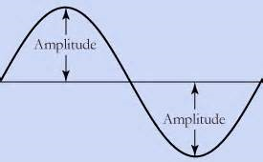
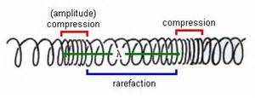
Amplitude
Amplitude = wave height

Slide 22
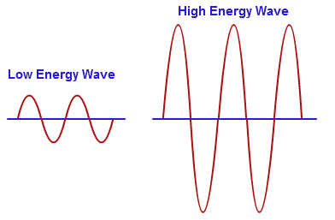
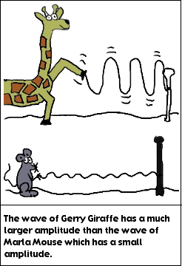
Amplitude
larger amplitude = more energy

Slide 23
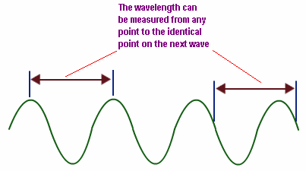
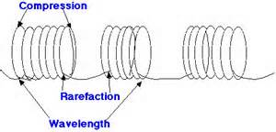
Wavelength
Wavelength = distance between 2 crests or troughs

Slide 24
Wavelength
human eyes can detect electromagnetic waves with a wavelength between 400 and 700 nanometers
1 nanometer = 1 of a meter!!!
1,000,000,000

Slide 25
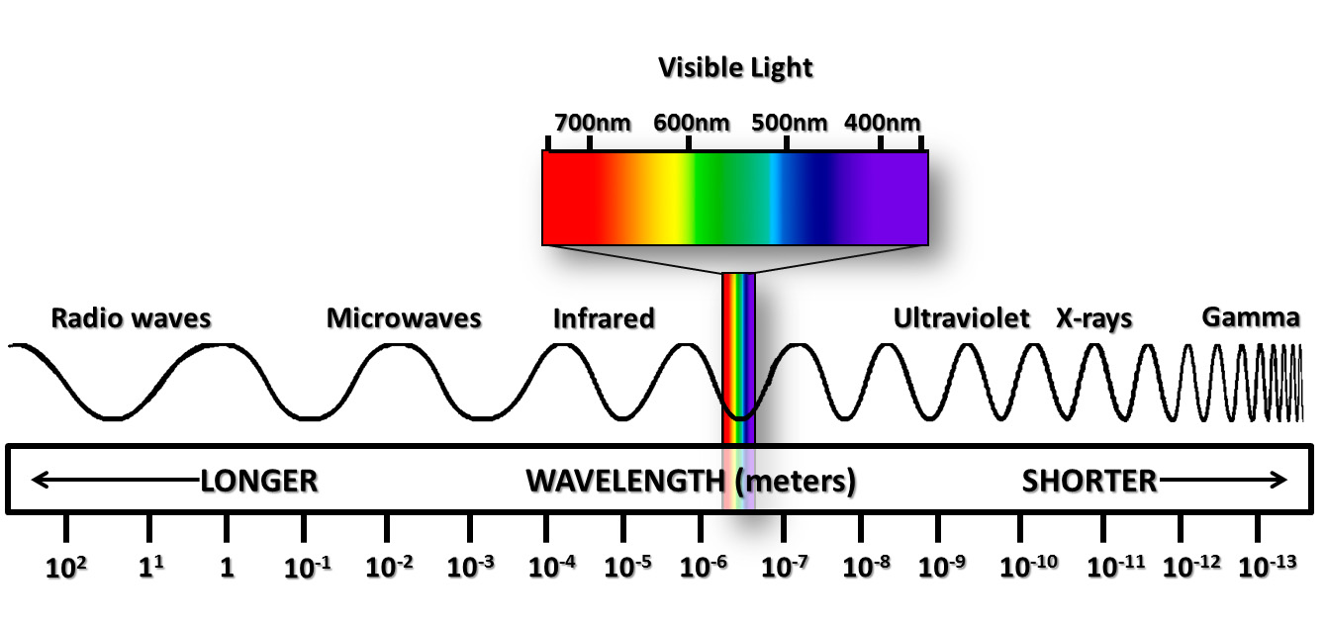
Wavelength
human eyes can detect electromagnetic waves with a wavelength between 400 and 700 nanometers

Slide 26
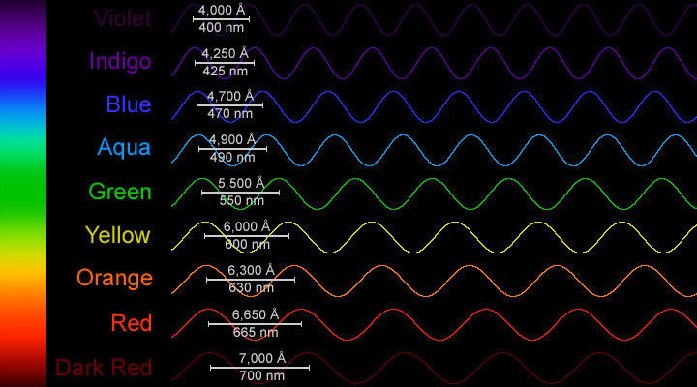
Wavelength
human eyes can detect electromagnetic waves with a wavelength between 400 and 700 nanometers

Slide 27
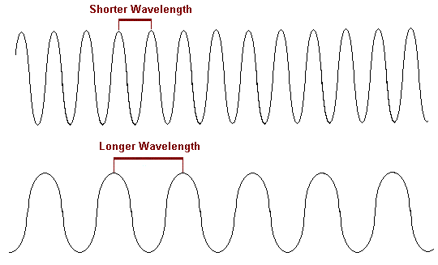
Wavelength
shorter wave length = more energy

Slide 28
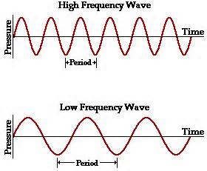
Frequency (Hertz / Hz)
Frequency = the number of waves that pass by a point each second

Slide 29
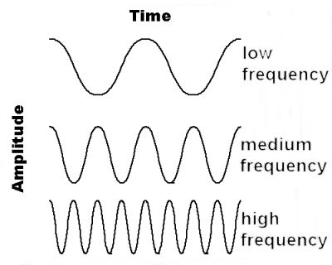
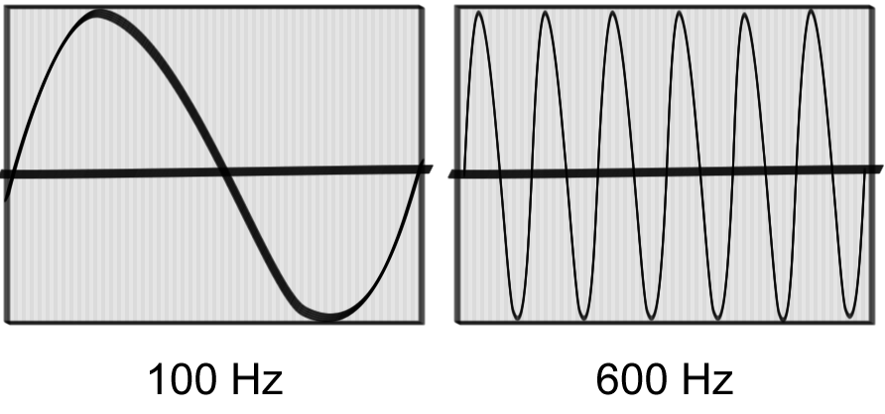
Frequency (Hertz / Hz)
higher frequency = more energy

Slide 30
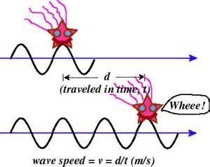
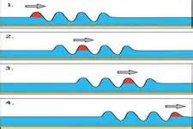
Wave Speed
Wave Speed = speed at which waves travel through a medium

Slide 31
VOCAB WORDS for Quiz
WAVE
MEDIUM
MECHANICAL WAVE
ELECTROMAGNETIC WAVE
LONGITUDINAL WAVE
TRANSVERSE WAVE
AMPLITUDE
FREQUENCY
WAVE SPEED
WAVE LENGTH

