Slide 1
Element Baby Book Project
Procedure and Example
Actual book must be used.

Slide 2
Cover Page 5pts.
Name of element
Picture of the element (in everyday use)
Your name
Decorative cover

Slide 3
Cover page (poor) example
LITHIUM
FROM: Mr. T

Slide 4
Better EXAMPLE
LITHIUM
From Mr. T

Slide 5
Birth Certificate 15pts.
Name (name of the element) Lithium
Nickname (symbol) Li
Birth Date (date element discovered) 1817
Birth Weight (atomic Mass) 6.941 amu
Birth Height (atomic number) 3
Race (type of element- metal, non-metal, metalloid) metal
Doctor (discoverer) Johan A. Arfvedson
Gender (state of matter at room temperature) solid
Place of birth (country of discovery) Sweden
Personality (boiling point & melting point) 1347 c/108.54c
Signature of Parent (that’s you!)
Make it look professional (border, seal of approval, etc...)

Slide 6
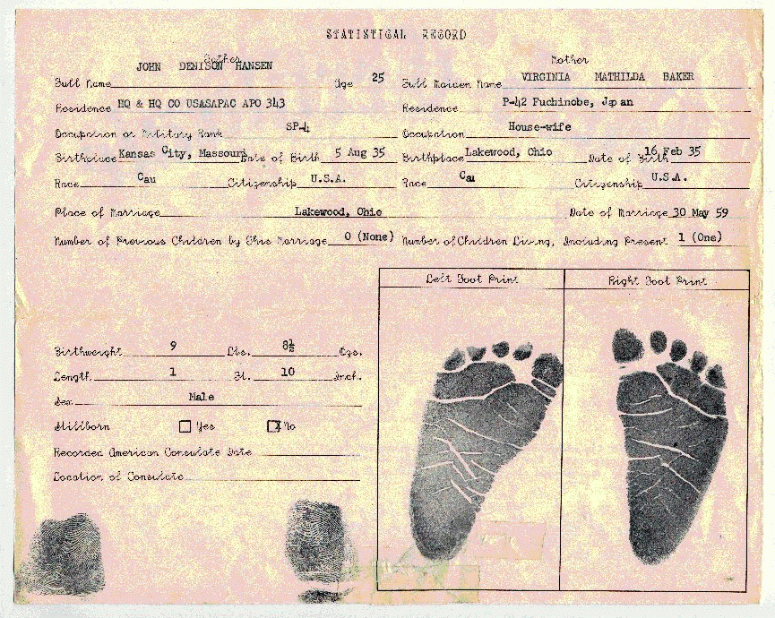
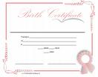
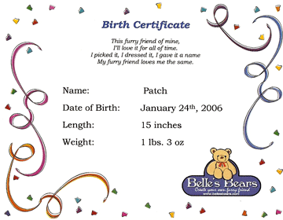
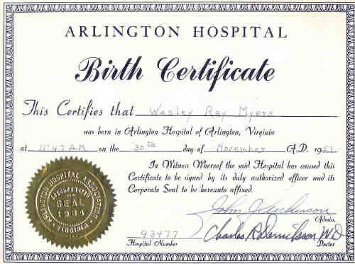
Birth Certificate examples Find a style you like and copy it with your elements info. (google images) or type it in yourself to a word document.

Slide 7
BIRTH CERTIFICATE
This is to certify that
LITHIUM
Birth Weight : 6.941 amu Birth Height: 3
Race: Metal Gender: Solid Nickname: Li
Personality: Boiling Point 1347C, Melting Point 108.54C
Was born in the year of 1817
in the country of Sweden.
Physician in attendance was Johan A. Arfvedson
Signature of Parent: Mr. T. Lithium Element

Slide 8
Family Tree 5 pts.
Create a family tree to place the following information.
Family name (name of the group it belongs to alkali metals, halogens, etc.)
Brothers and sisters(names of the group members)

Slide 9
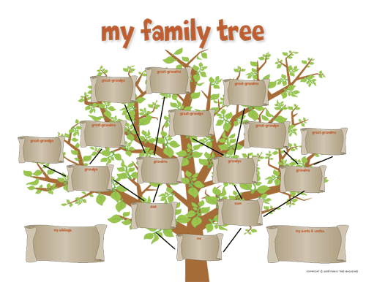
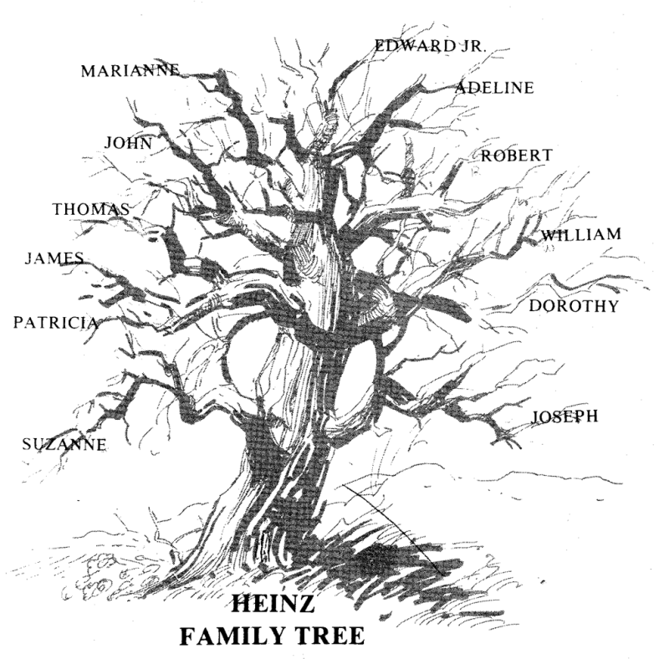
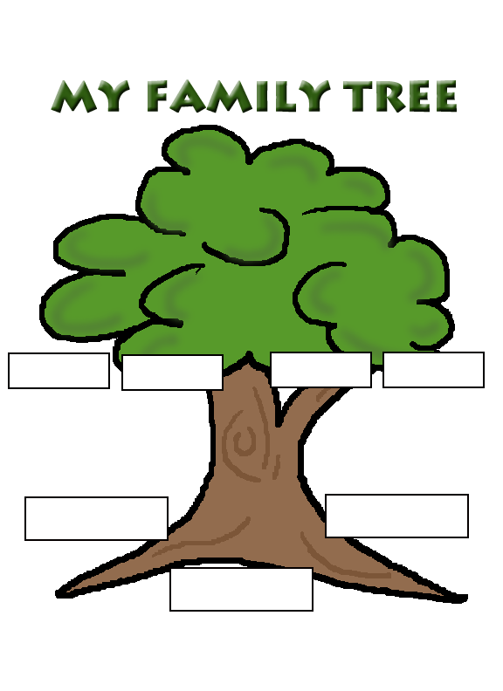
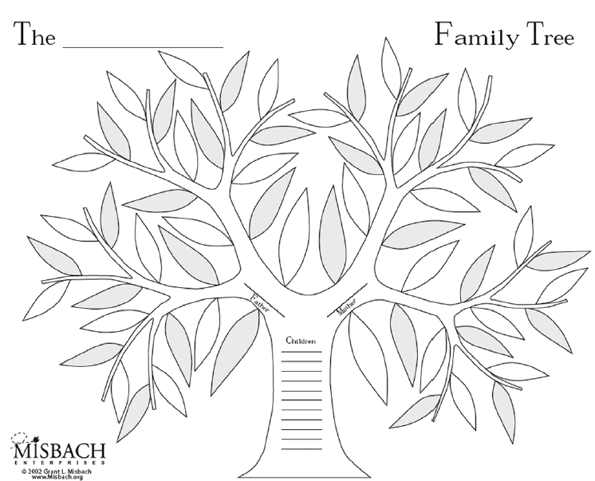
Family Tree examples

Slide 10
The Alkali Metal Family, Group I
Hydrogen
Sodium
Potassium
Rubidium
Cesium
Francium
Lithium

Slide 11
When I Grow Up 10pts.
In a paragraph of 8 sentences or more, explain the following:
Career choice ( what is your element going to be used for)
A picture of the career (use a different picture then the one used for the cover)
Explain it in the 1st person

Slide 12
Lithium
When I grow up I want to be used in Lithium-ion batteries. I live in Bolivia now and I am waiting for the scientists to mine me and bring me to Europe where I will be put to use in hybrid and electric cars.
In the past, Lithium was used for mood stabilizing drugs and thermonuclear weapons. Now Blackeberrys, electronic devices and the automotive industry need me mineral more.
Lithium is lighter then nickel and stores more energy. Governments are fighting to purchase me now. I hope to go to Mitsubishi and be used in one of their electric cars some day.

Slide 13
The Story of Me
For a baby, I’m actually really old. I’ve actually been around almost since the Big Bang. You can usually find baby elements like me paired up in a compound, because I’m highly reactive. I’m reactive because I love to share my single electron and become a cation. I’m a giver, that’s what I do! I’m an old softie, so soft that you could cut me with a knife, but please don’t do that because I oxidize quickly. You can usually find me around the rocks (in the Earth’s crust) or near the oceans. Babies like me don’t come along every day, because I’m only the 25th most abundant element. I am really popular though, because of my usefulness in the medical field, batteries used in electronics, and as a lubricant for manufacturing!

